Slide 1

使用 H₂O 进行机器学习
概观
公司 / 人员
开源的H2O机器学习平台 – H2O-3
概观
信用卡风险示例
商业的H2O机器学习平台 -Driverless AI
概观
信用卡风险示例
Q & A 提问
Jo-fai (Joe) Chow 周祖輝
数据科学家
joe@h2o.ai

Slide 2

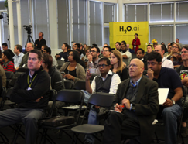


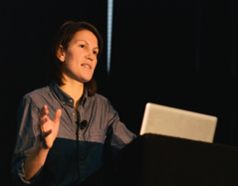

公司简介
Founded 成立 | 2011年获得风险投资支持，在2012年首次亮相
Products 产品 | H₂O Open Source Machine Learning Platform 开源的H2O机器学习平台 Sparkling Water (H₂O + Spark) Enterprise Steam Driverless AI (商业的H2O机器学习平台)
Mission 任务 | Operationalize Data Science, and provide a platform for users to build beautiful data products 实现数据科学的操作化，为用户构建美丽的数据产品提供平台
Team 团队 | 75 人 分布式系统工程师 机器学习专家 世界级的可视化设计师
HQ 总部 | Mountain View, California 加州山景城

Slide 3
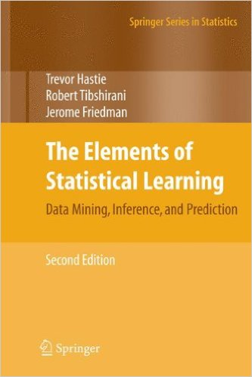

Scientific Advisory Council 科学咨询委员会

Slide 4
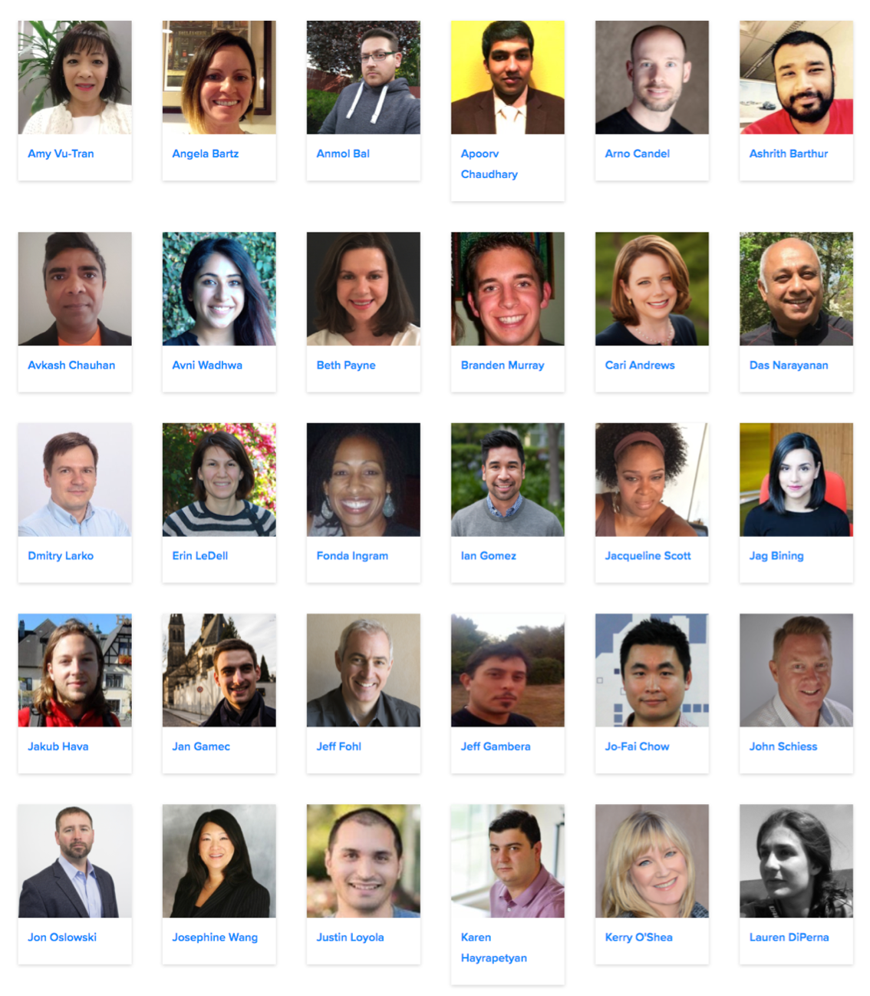
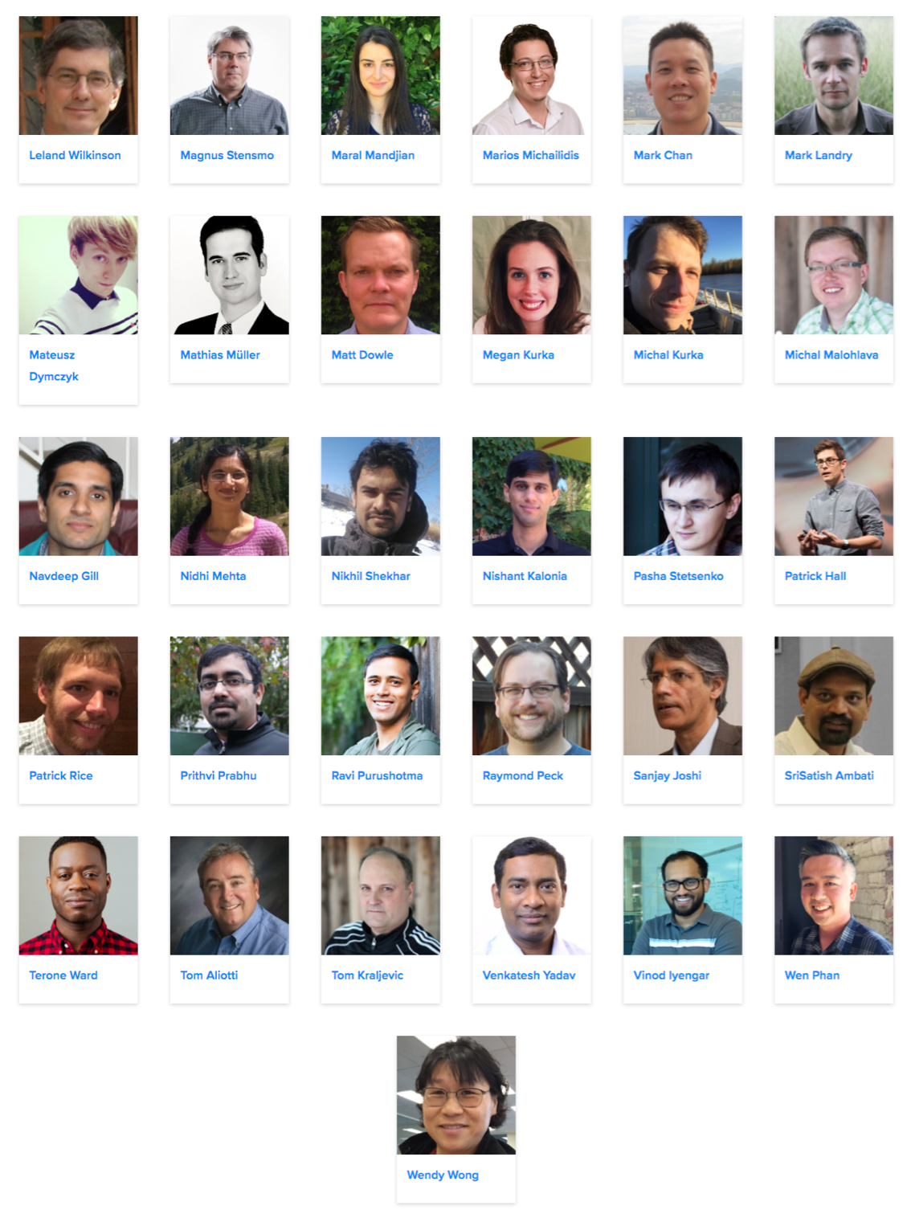
H₂O 团队

Slide 5
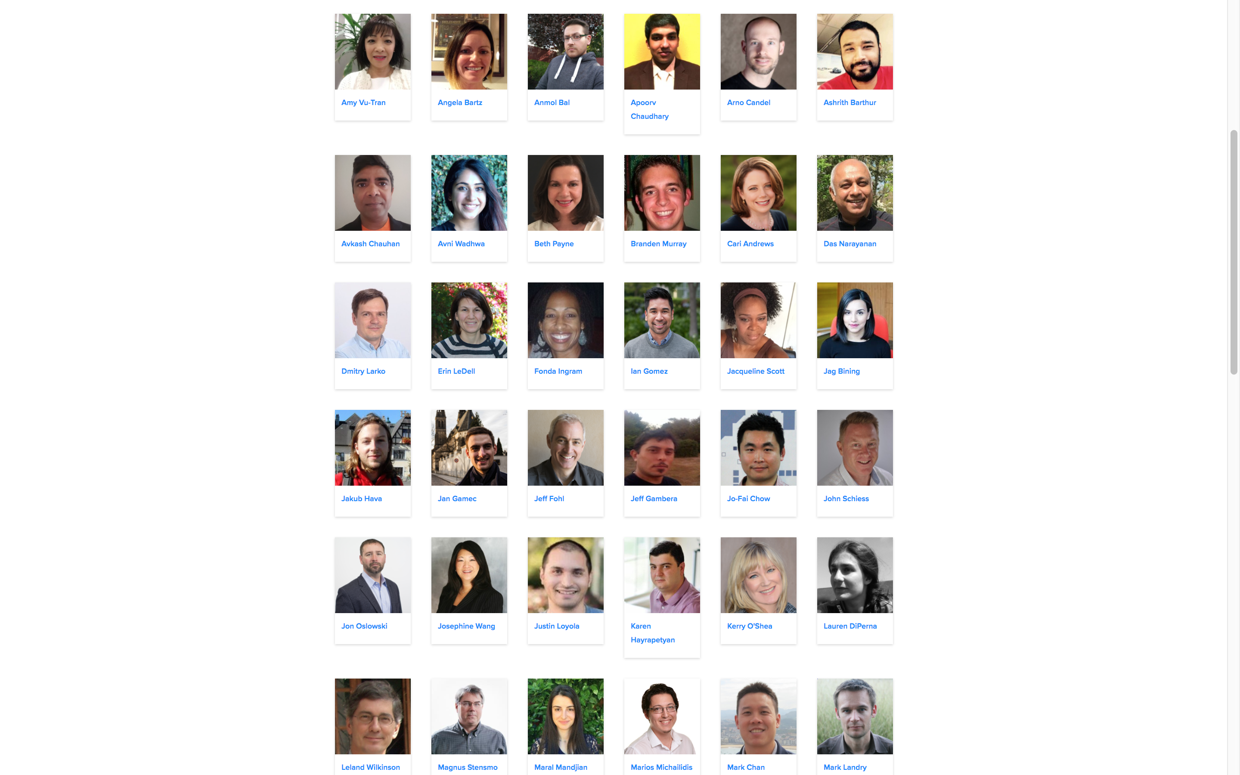
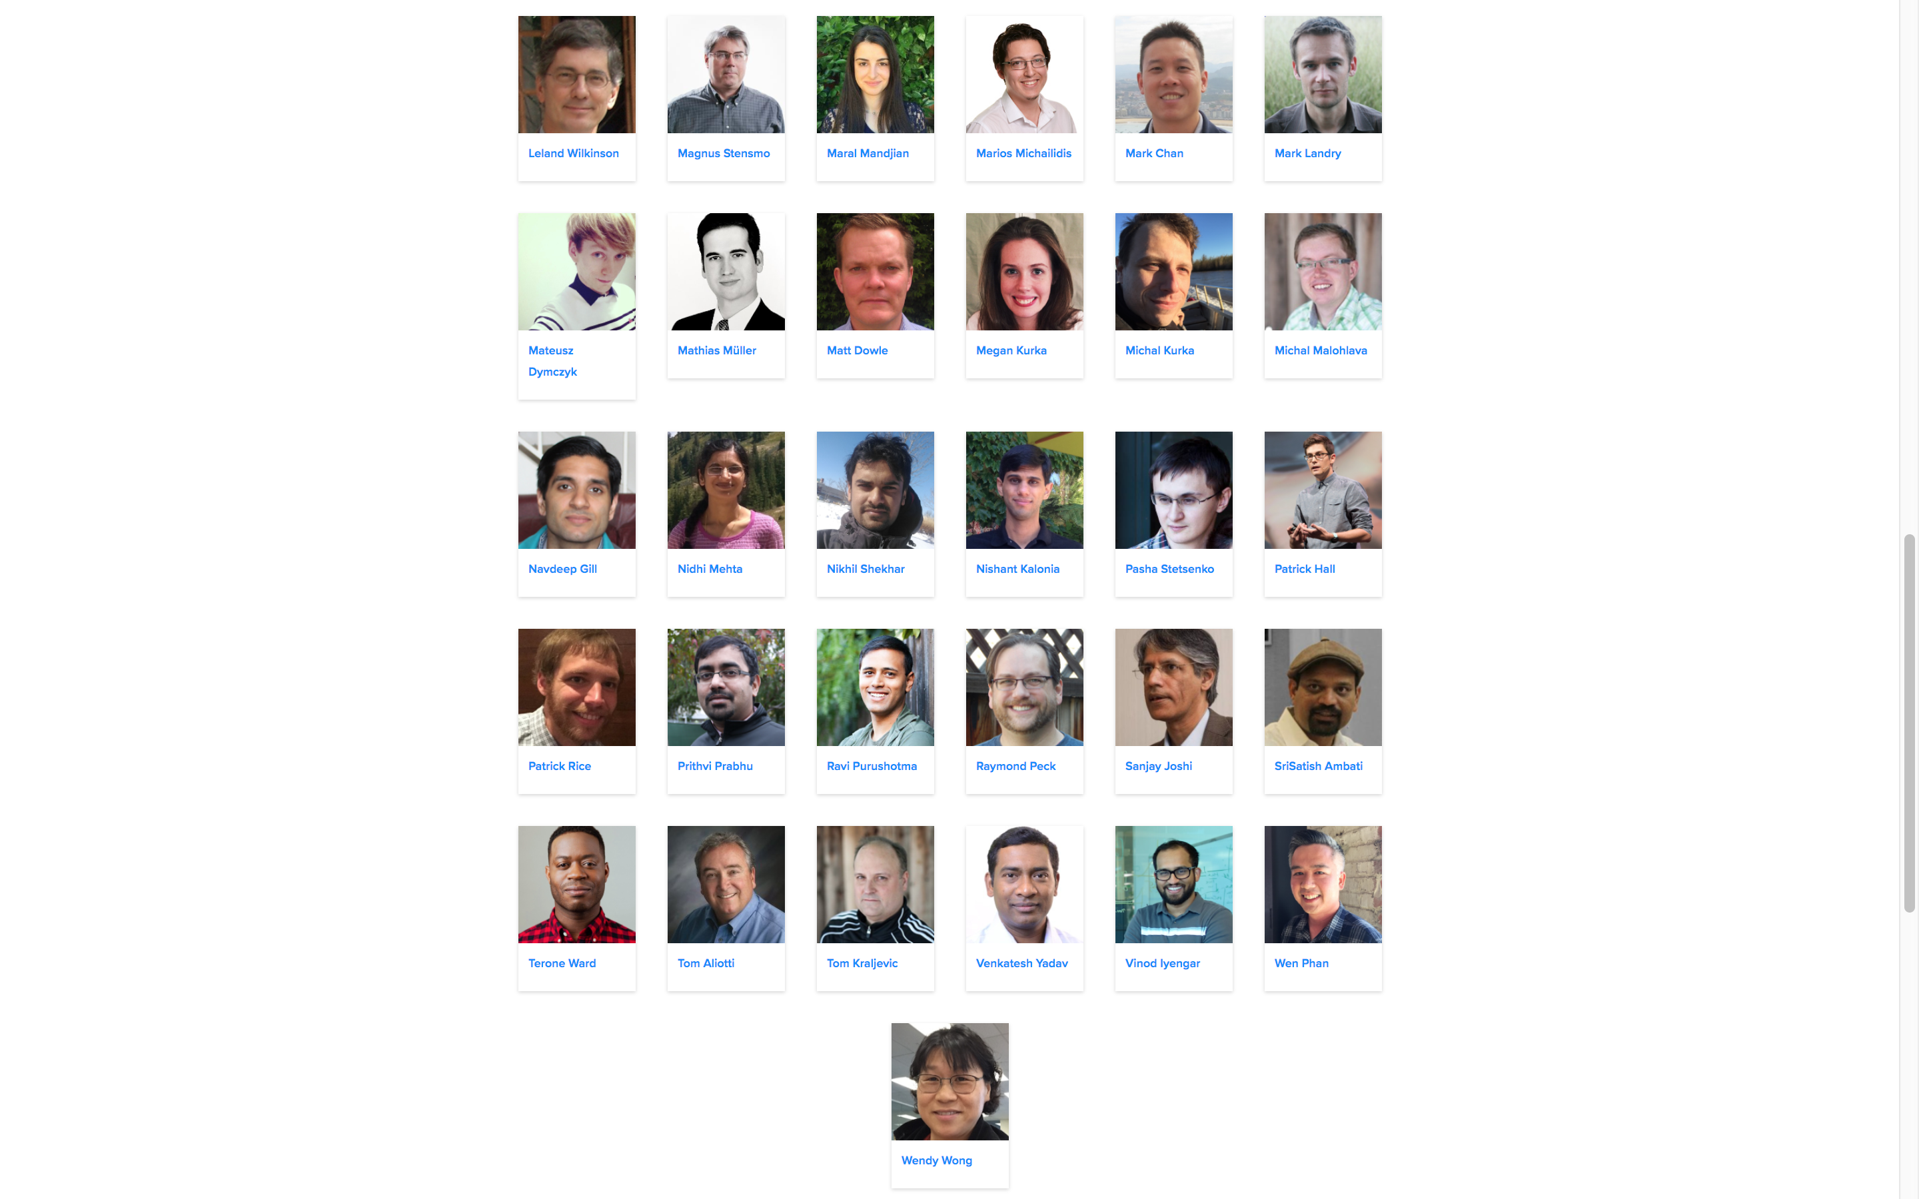

H₂O 欧洲团队(2016)

Slide 6
H₂O 欧洲团队(2017)
英国
德国
捷克
英国

Slide 7

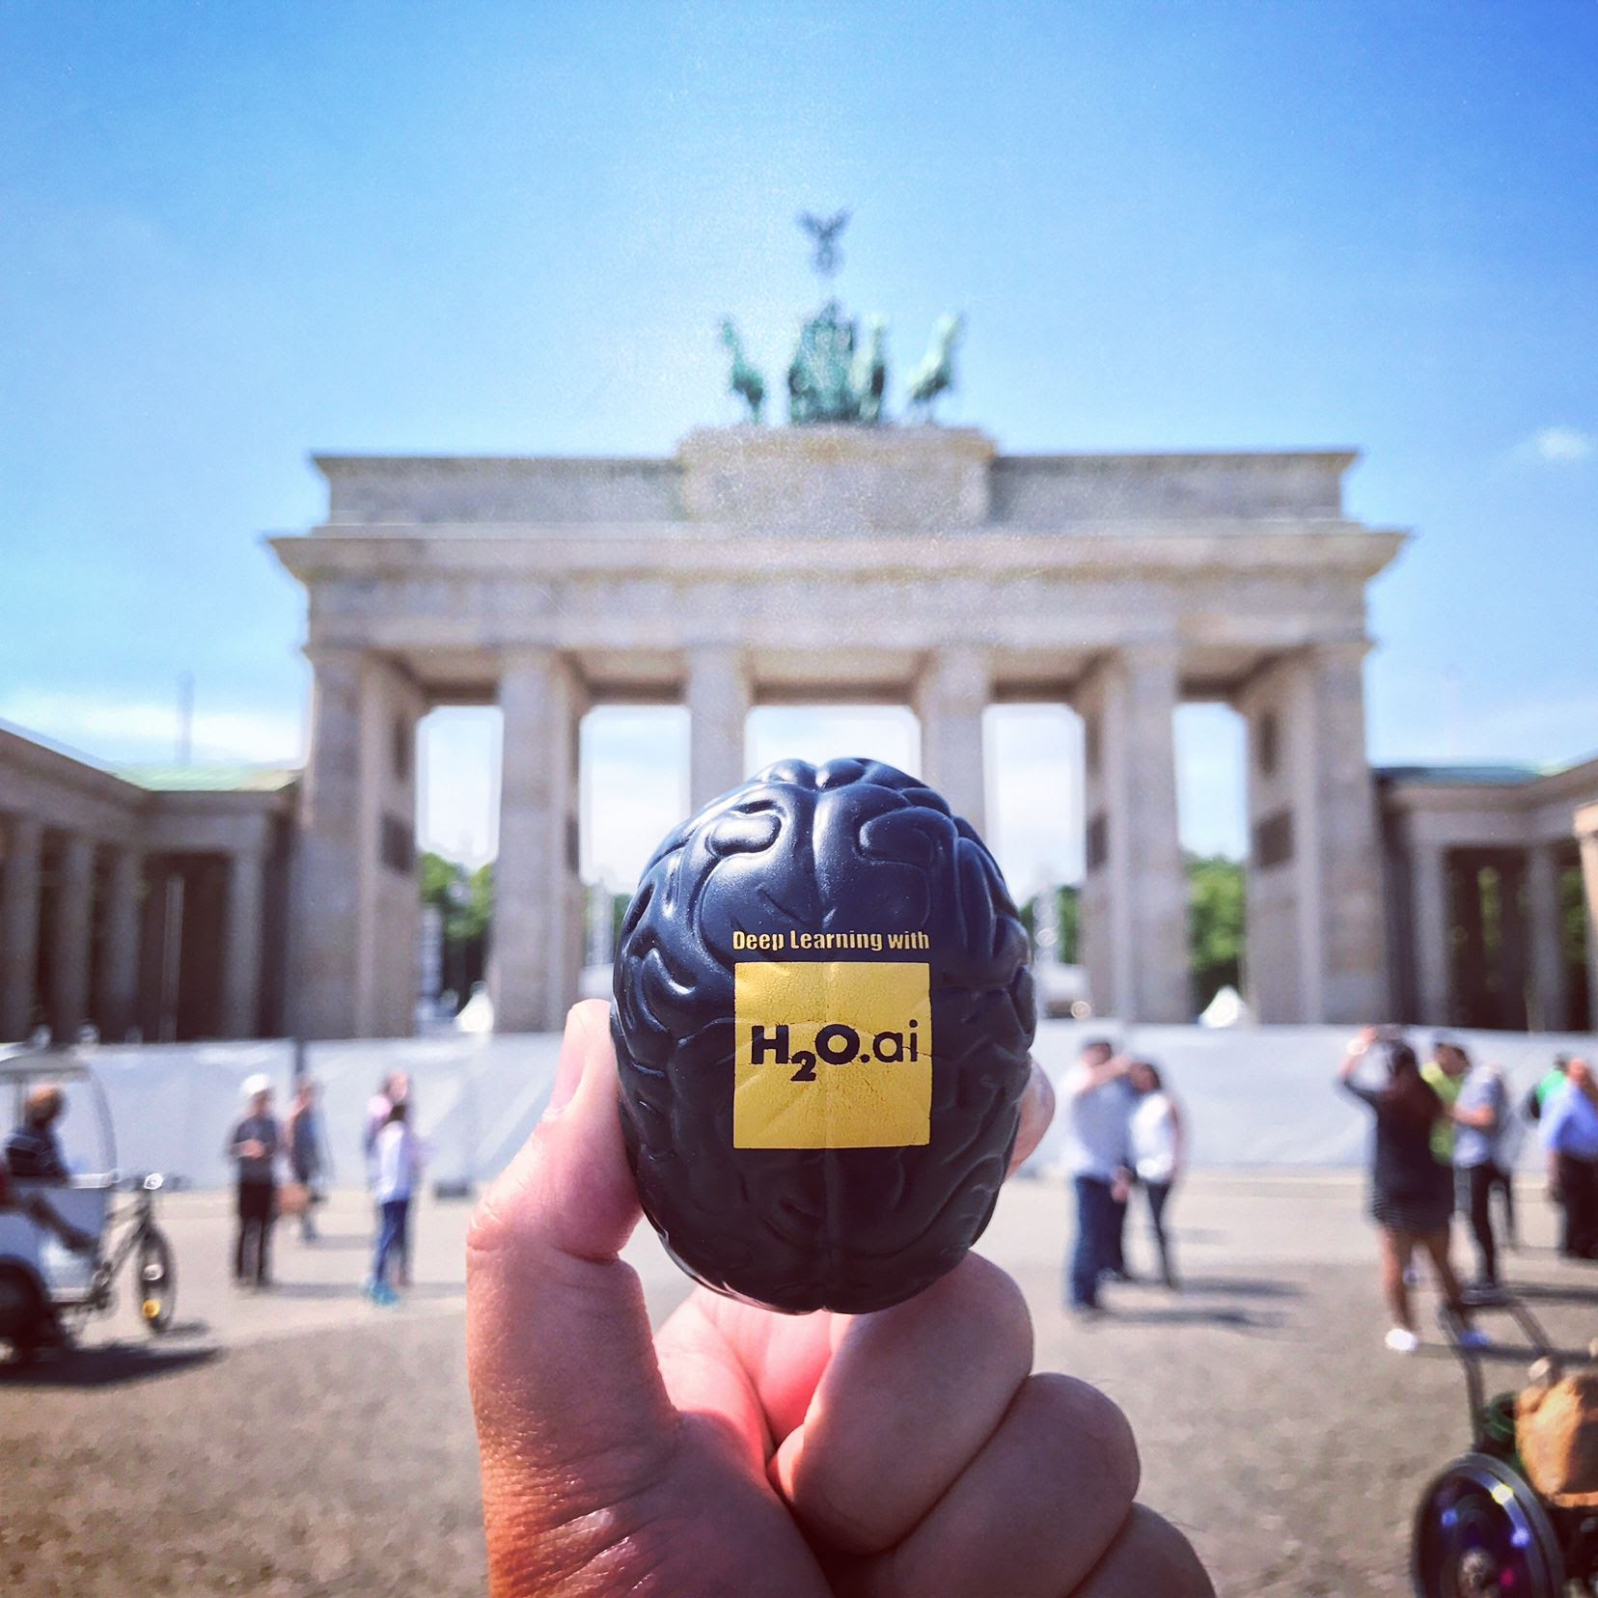

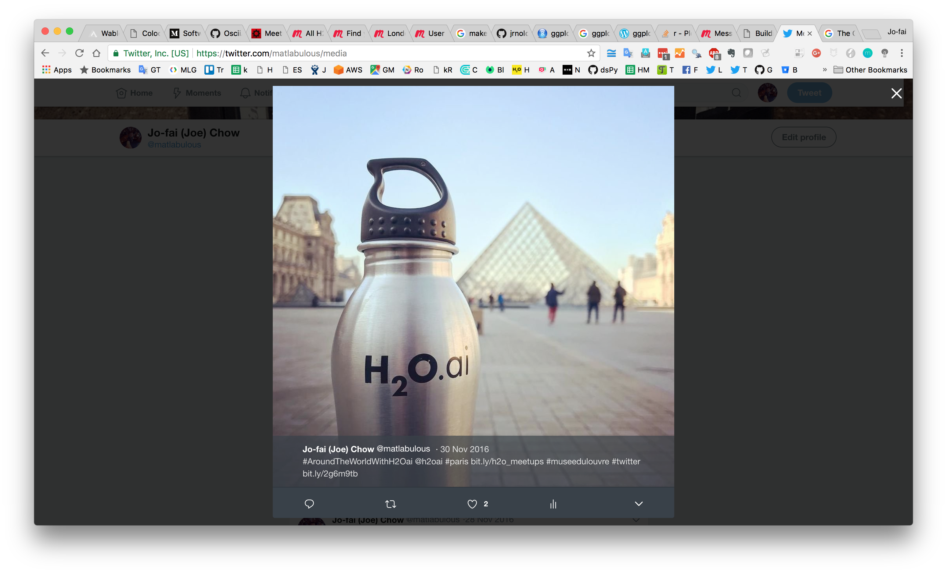
What is Joe’s role at H₂O.ai 我的职责
Data Scientist (数据科学家) / Sales Engineer (销售) / Meetup Organizer (Meetup组织者) (on paper)
Unofficial Photographer of H2O.ai SWAG (非官方摄影师) (the travelling data scientist)

Slide 8

#AroundTheWorldWithH2Oai
研讨会,
会议 & 教程
超过 25 城市
(2017)
Month | Joe’s H₂O Events in 2017
Jan | London
Feb | London, Warsaw, Oxford
Mar | Bay Area, London, Cologne, Barcelona, Madrid, Vienna
Apr | Amsterdam, Rotterdam, Poznan, London
May | Belgrade, Hamburg, Berlin
Jun | Amsterdam, Stockholm, Budapest, London, Munich, Prague
Jul | Berlin, Brussels
Aug
Sep | London, Dublin
Oct | Exeter, Munich, Dublin, The Hague, Amsterdam, Frankfurt
Nov | Munich, Zurich, London, Glasgow
Dec | Bay Area, London

Slide 9
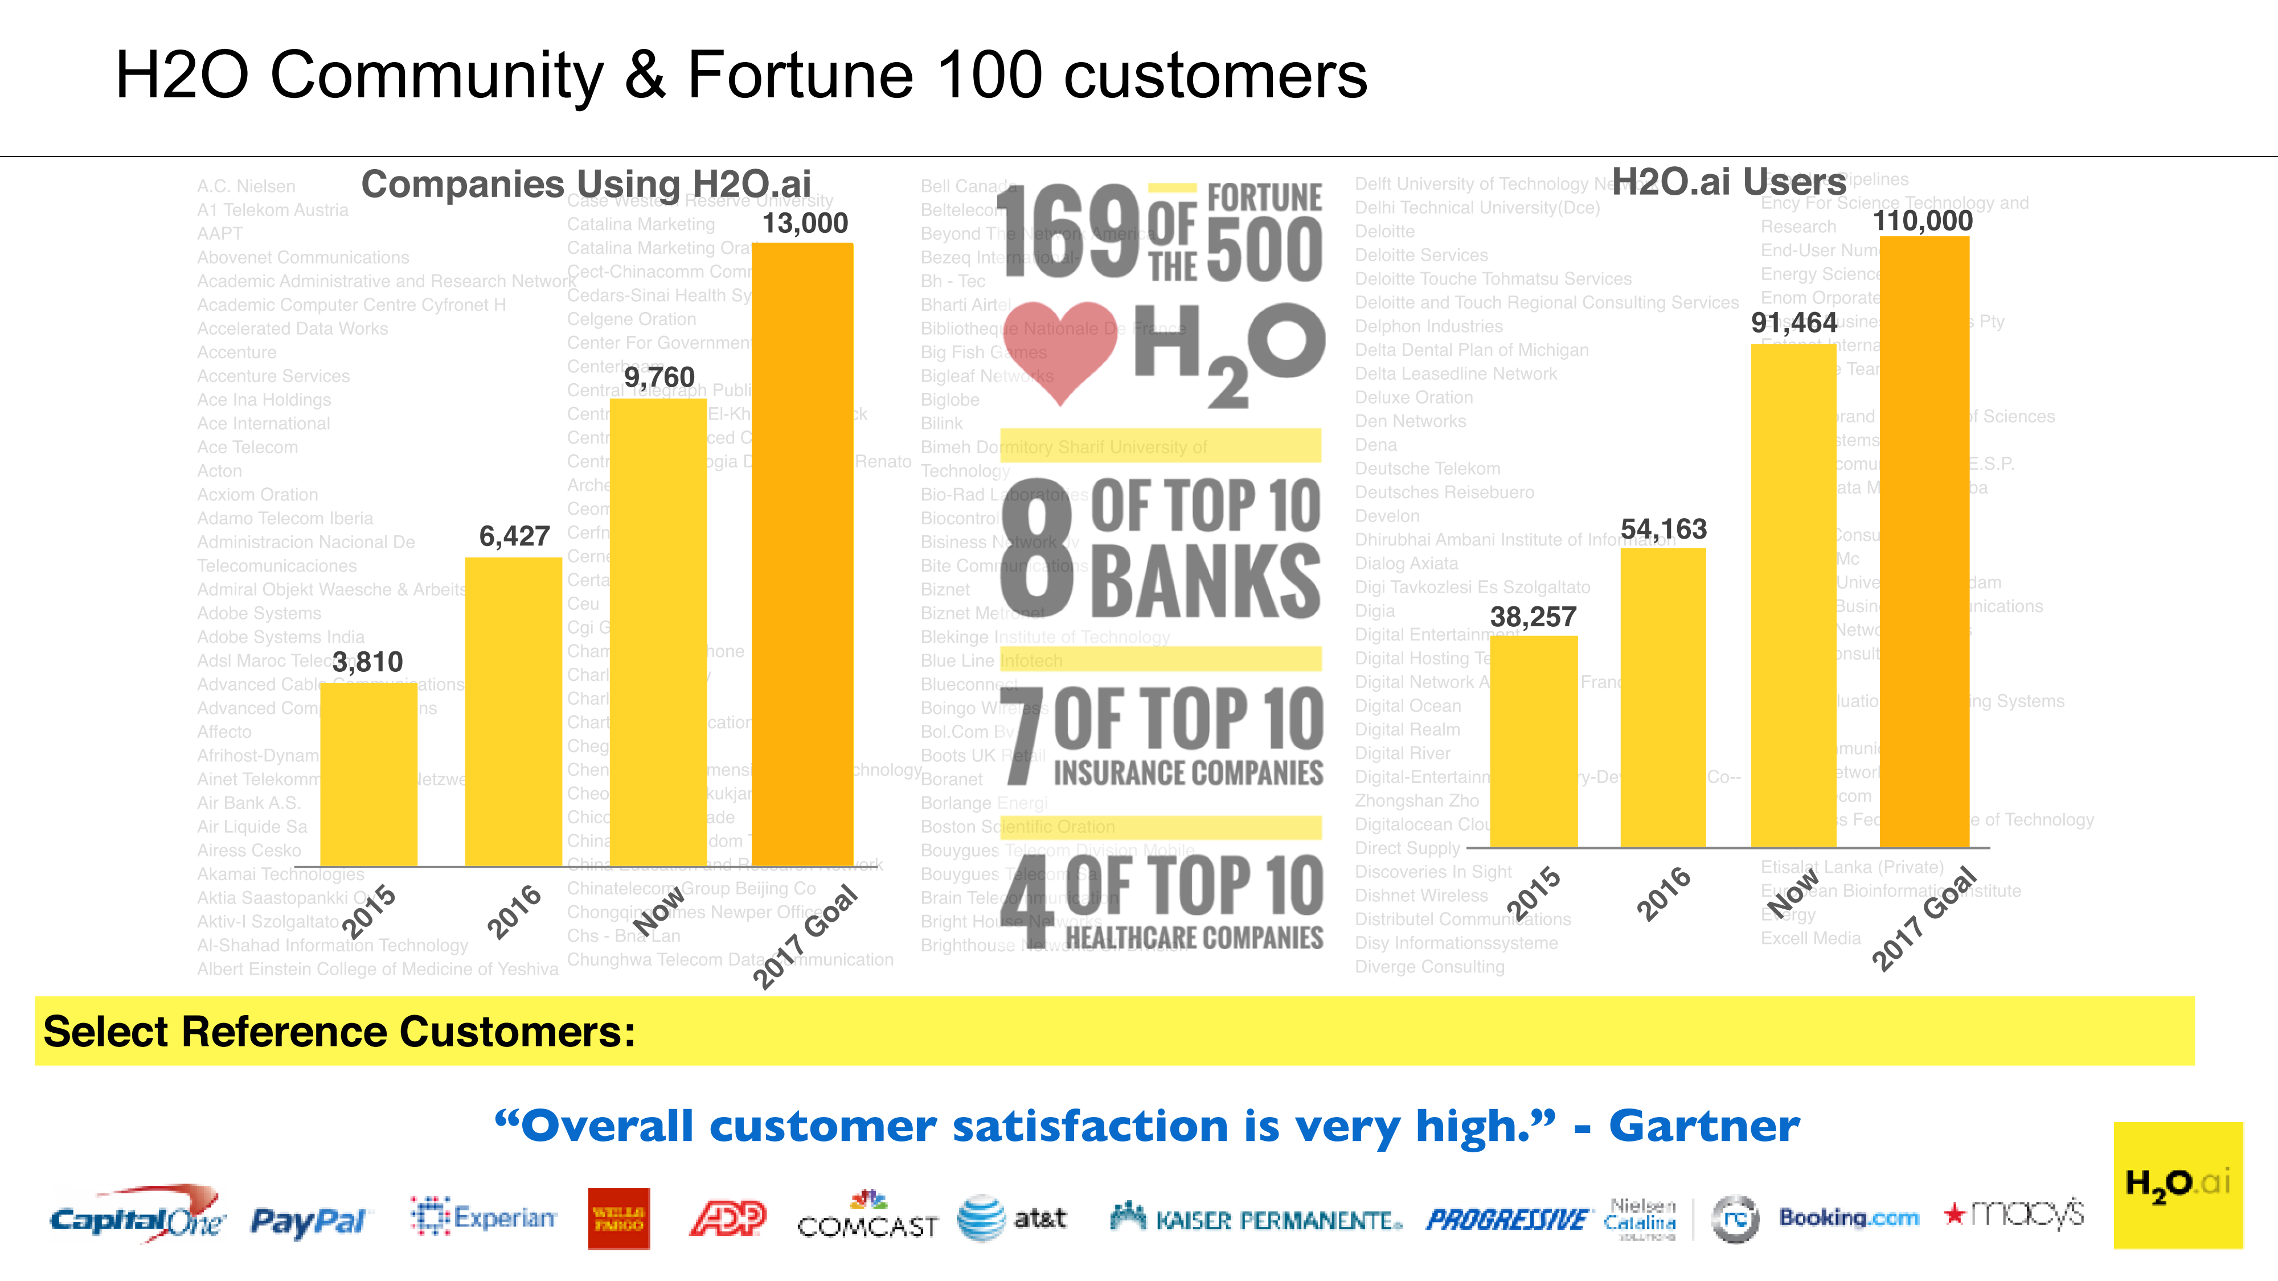
H₂O Community Growth
社区和客户
H2O的用家
使用H2O的公司

Slide 10

































客户
Retail
Healthcare
Marketing
Financial
Advisory & Accounting
Insurance
Telecom
“Overall customer satisfaction is very high.” – Gartner (整体客户满意度非常高)
Notes:
Get a better icon for Advisory and accounting category, use the work assurance, Consider using graphs behind to scale, make it a normal curve, Horizontal, Fortune 500 customers, How many are using H2O

Slide 11







AI in Financial Services (金融服务 AI 应用)
Wholesale / Commercial Banking 批发/商业银行
IT Infrastructure IT基础设施
Know Your Customers 了解你的客户
Anti-Money Laundering 反洗黑钱
Security Cyberlake 网路安全
Denial-of-Service Detection and Protection 拒绝服务 (DoS) 检测和保护
Master Data Management 数据管理
Retail Banking 零售银行
Card/Payments Business 卡/付款业务
Deposit Fraud 欺诈存款
Customer Churn Prediction 客户流失预测
Auto-Loan 自动贷款
Transaction Frauds 交易欺诈
Real-time Targeting 实时定位
Credit Risk Scoring 信用风险评分
In-Context Promotion 促销
今天的例子

Slide 12
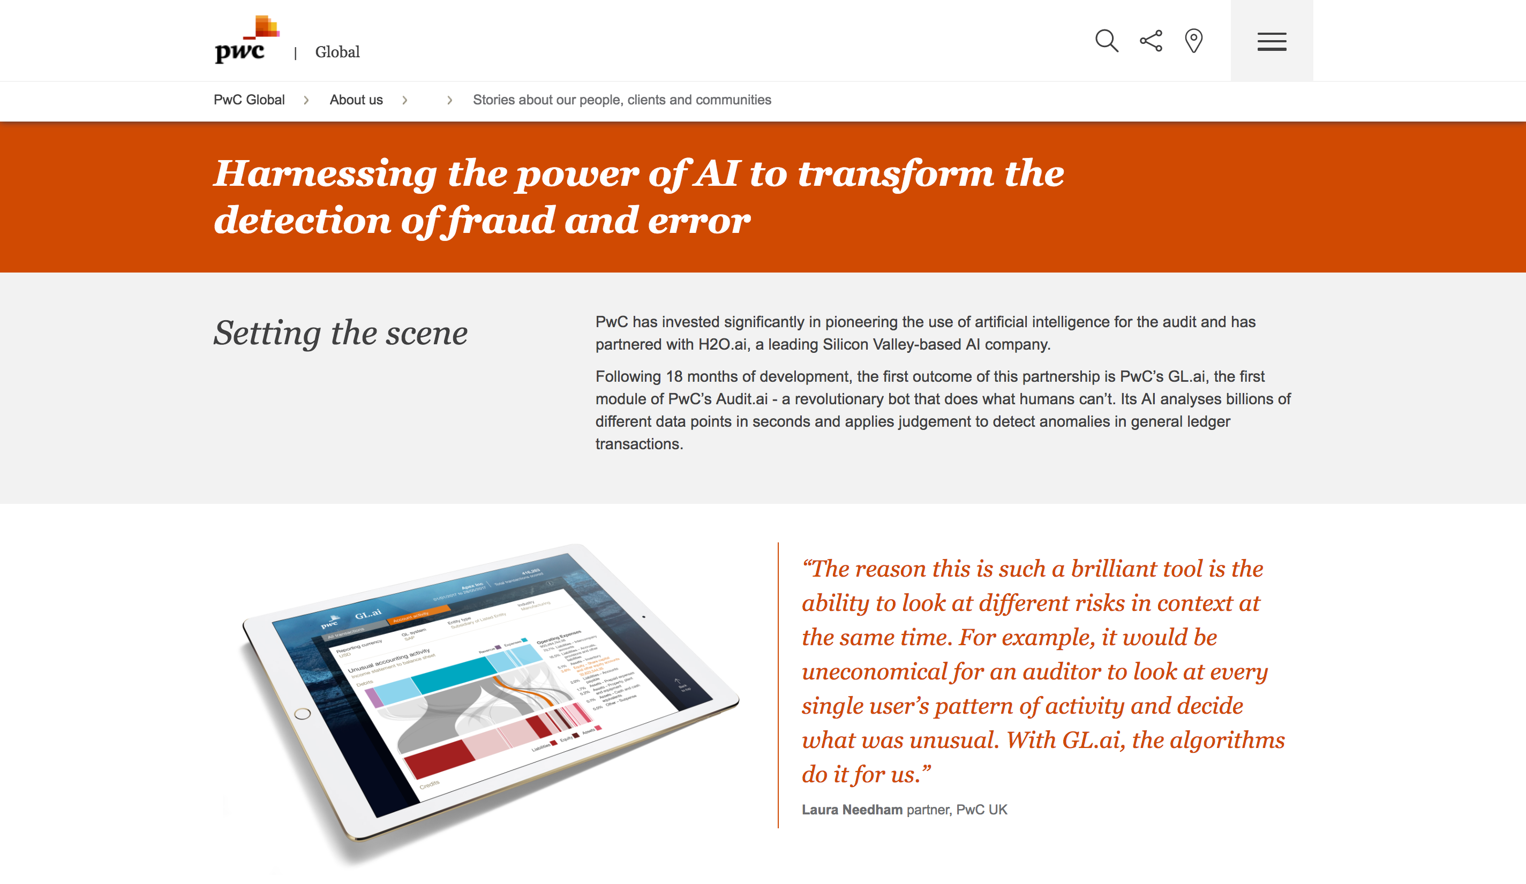

Award-Winning Application (PwC + H₂O.ai) 获奖的项目
审计创新奖
http://www.pwc.com/gx/en/about/stories-from-across-the-world/harnessing-the-power-of-ai-to-transform-the-detection-of-fraud-and-error.html
Notes:
Works on Hadoop & Spark
Key capabilities
Distributed in-memory algorithms
Columnar compression
Feature Engineering
EDA
Data Munging
Supervised Learning Algorithms
Unsupervised Learning Algorithms
Model deployment via POJO

Slide 13
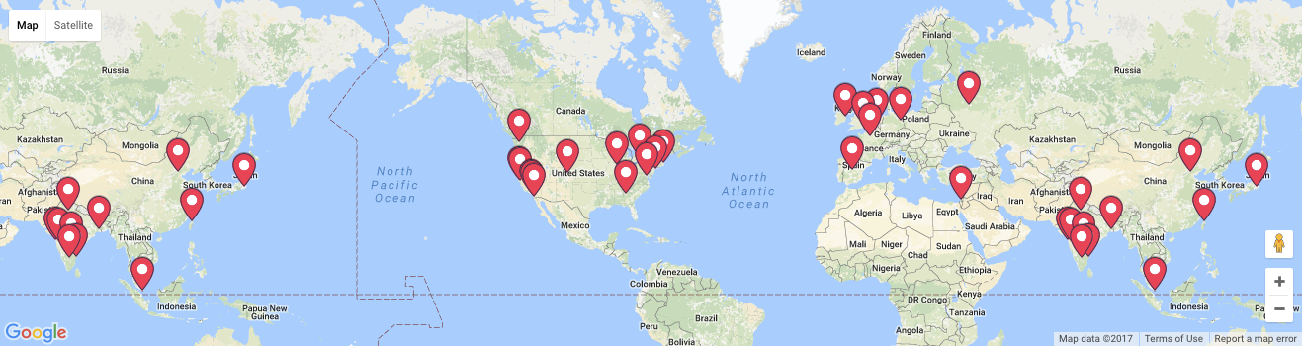

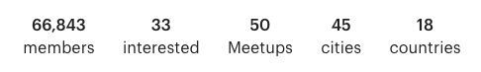

Community Expansion 社区扩展
每个月15次 Meetup (技术讨论会)
了解更多: www.h2o.ai/community/
Notes:
Note meetups groups were just opened from Feb 7-10.

Slide 14
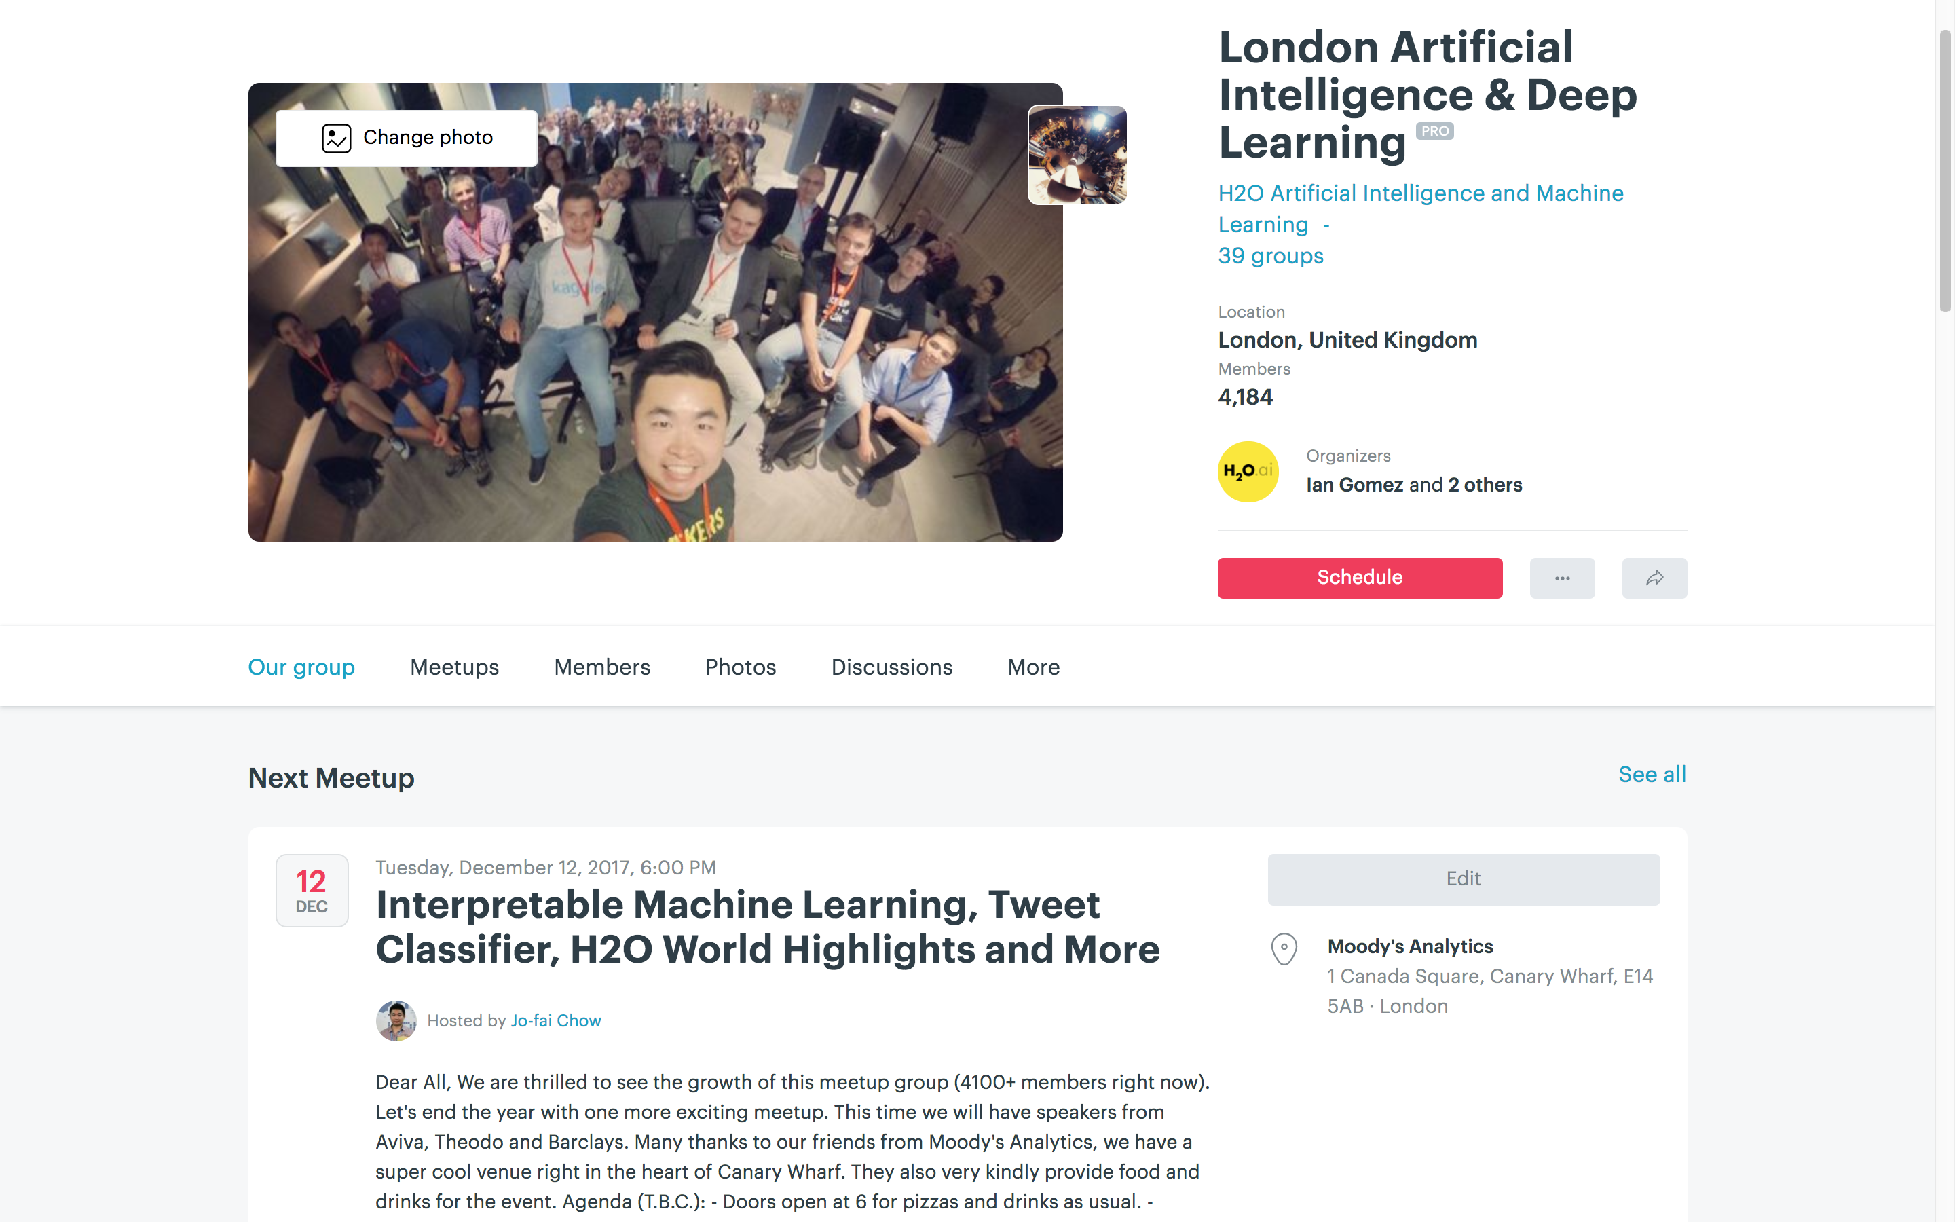
我们的伦敦聚会小组
4100+ 会员
Next London Meetup: 12 Dec at Moody’s London HQ

Slide 15

H2O 会议
加州山景城

Slide 16

H₂O Machine Learning Platform
开源的 H₂O 机器学习平台

Slide 17



High Level Architecture 架构
HDFS
H₂O Compute Engine
S3
Load Data
Exploratory &
Descriptive
Analysis
Supervised &
Unsupervised
Modeling
Predict
Distributed
In-Memory
NFS
Feature Engineering &
Selection
Model Evaluation &
Selection
Data & Model Storage
Loss-less
Compression
Local
Data Prep Export:
Plain Old Java Object
Model Export:
Plain Old Java Object
SQL
Production Scoring Environment
Your
Imagination
Notes:
Works on Hadoop & Spark
Key capabilities
Distributed in-memory algorithms
Columnar compression
Feature Engineering
EDA
Data Munging
Supervised Learning Algorithms
Unsupervised Learning Algorithms
Model deployment via POJO

Slide 18
High Level Architecture
从多个来源导入数据
HDFS
H₂O Compute Engine
S3
Load Data
Exploratory &
Descriptive
Analysis
Supervised &
Unsupervised
Modeling
Predict
Distributed
In-Memory
NFS
Feature Engineering &
Selection
Model Evaluation &
Selection
Data & Model Storage
Loss-less
Compression
Local
Data Prep Export:
Plain Old Java Object
Model Export:
Plain Old Java Object
SQL
Production Scoring Environment
Your
Imagination
Notes:
Works on Hadoop & Spark
Key capabilities
Distributed in-memory algorithms
Columnar compression
Feature Engineering
EDA
Data Munging
Supervised Learning Algorithms
Unsupervised Learning Algorithms
Model deployment via POJO

Slide 19
Supported Formats & Data Sources 支持的格式和数据源
File type or Folder of Files
CSV
XLS
XLSX
ORC*
Hive*
SVMLight
ARFF
Parquet
Avro 1.8.0*
HDFS
9 Formats
5 Sources
S3
NFS
LOCAL
SQL
* 1. only if H2O is running as a Hadoop job
* 2. Hive files that are saved in ORC format
* 3. without multi-file parsing or column type modification
Notes:
With the H2O integration for Hadoop you can import a whole range of different file formats including ….
If you have a directory of files with the same shape and labeling you can simply point to the directory path and H2O will combine all
those datasets into a single frame. This is particularly helpful if you use Hive because Hive queries result in lots of part files save to one big directory.
These supported file types can be ingested from any of the following data sources ...
CSV (delimited) files
ORC only if H2O is running as a Hadoop job.
SVMLight
ARFF
XLS
XLSX
Avro version 1.8.0 (without multifile parsing or column type modification)
Parquet
Hive files that are saved in ORC format.

Slide 20
High Level Architecture
快速，可扩展和分布式计算引擎
HDFS
H₂O Compute Engine 计算引擎
S3
加载数据
探索性和描述性分析
有监督和无监督
建模
预测
分布式内存
NFS
特征工程和选择
数据和
模型存储
无损压缩
模型评估和选择
Local
Data Prep Export:
Plain Old Java Object
Model Export:
Plain Old Java Object
SQL
Production Scoring Environment
Your
Imagination
Notes:
Works on Hadoop & Spark
Key capabilities
Distributed in-memory algorithms
Columnar compression
Feature Engineering
EDA
Data Munging
Supervised Learning Algorithms
Unsupervised Learning Algorithms
Model deployment via POJO

Slide 21
High Level Architecture
分布式算法
HDFS
H₂O Compute Engine
S3
Load Data
Exploratory &
Descriptive
Analysis
有监督和无监督
建模
Predict
Distributed
In-Memory
NFS
Feature Engineering &
Selection
Data & Model Storage
Loss-less
Compression
模型评估和选择
Local
Data Prep Export:
Plain Old Java Object
Model Export:
Plain Old Java Object
SQL
Production Scoring Environment
Your
Imagination
Notes:
Works on Hadoop & Spark
Key capabilities
Distributed in-memory algorithms
Columnar compression
Feature Engineering
EDA
Data Munging
Supervised Learning Algorithms
Unsupervised Learning Algorithms
Model deployment via POJO

Slide 22

Distributed Algorithms 分布式算法
Advantageous Foundation 有利的基础
Foundation for In-Memory Distributed Algorithm Calculation - Distributed Data Frames and columnar compression 分布式数据帧和列压缩
All algorithms are distributed in H₂O: GBM, GLM, DRF, Deep Learning and more. Fine-grained map-reduce iterations.
Only enterprise-grade, open-source distributed algorithms in the market 企业级开源分布式算法
Parallel Parse into Distributed Rows
分布式并行分析
Foundation for Distributed Algorithms
分布式算法基础
User Benefits 用户利益
“Out-of-box” functionalities for all algorithms (NO MORE SCRIPTING) and uniform interface across all languages: R, Python, Java “开箱即用”功能, 多介面
Designed for all sizes of data sets, especially large data 适用于各种规模的数据集，特别是大型数据
Highly optimized Java code for model exports
In-house expertise for all algorithms
Fine Grain Map Reduce Illustration: Scalable Distributed Histogram Calculation for GBM
分布式计算
Notes:
GBM authors from Stanford on Scientific Advisory Council

Slide 23
Algorithms Overview 算法概述
Supervised Learning 监督学习
Unsupervised Learning 无监督学习
Statistical Analysis
Generalized Linear Models: Binomial, Gaussian, Gamma, Poisson and Tweedie
Naïve Bayes
K-means: Partitions observations into k clusters/groups of the same spatial size. Automatically detect optimal k
Clustering
Distributed Random Forest: Classification or regression models
Gradient Boosting Machine: Produces an ensemble of decision trees with increasing refined approximations
Principal Component Analysis: Linearly transforms correlated variables to independent components
Generalized Low Rank Models: extend the idea of PCA to handle arbitrary data consisting of numerical, Boolean, categorical, and missing data
Dimensionality Reduction
Ensembles
Deep Neural Networks
Deep learning: Create multi-layer feed forward neural networks starting with an input layer followed by multiple layers of nonlinear transformations
Anomaly Detection
Autoencoders: Find outliers using a nonlinear dimensionality reduction using deep learning

Slide 24
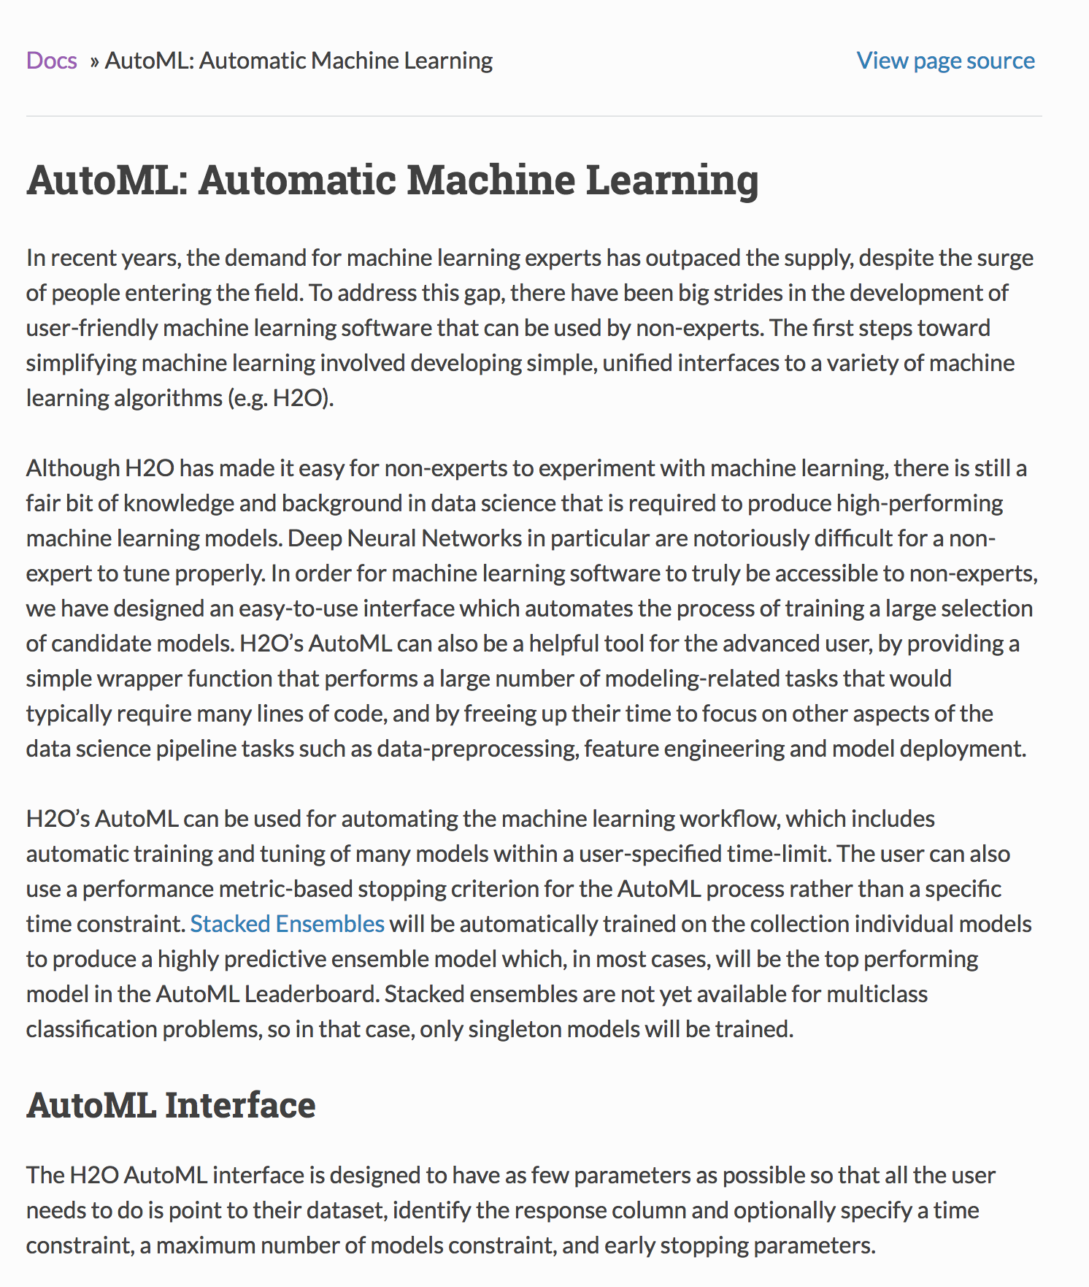
自动机器学习

Slide 25
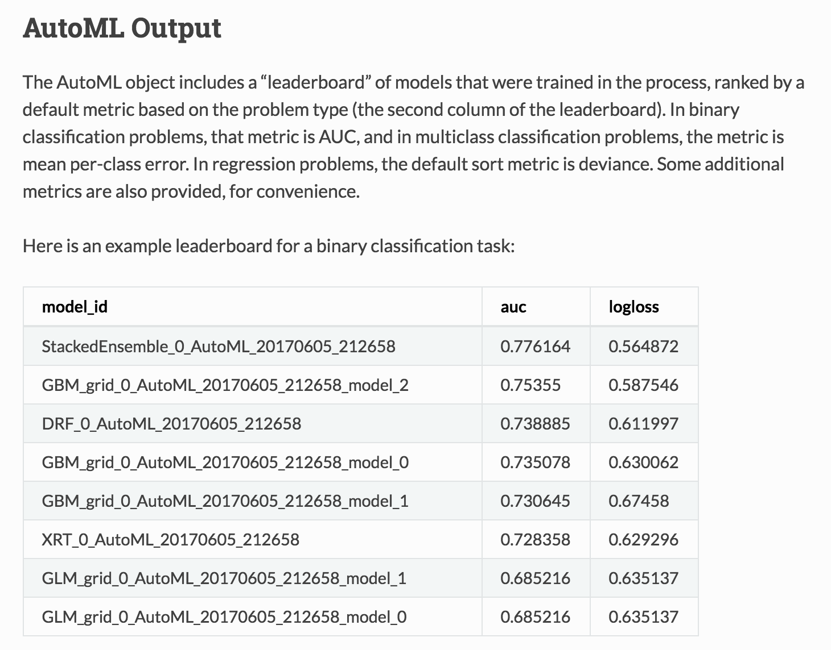
自动机器学习

Slide 26

H₂O Core 核心
H2O

Slide 27




H₂O Core 核心
建模
Model Building
记忆体
CPU
中央处理器
硬盘

Slide 28
H₂O Core 核心
H2O
H2O
H2O

Slide 29
H₂O Core 核心
Model Building
H2O Distributed In-Memory
H2O分布式内存
CPU
CPU
CPU

Slide 30







H₂O Core 核心
Model Building
SQL
NFS
H2O Distributed In-Memory
H2O分布式内存
S3
CPU
CPU
CPU
其他数据源
YARN

Slide 31
H₂O Core 核心
Firewall or Cloud 防火墙或云
Model Building
SQL
NFS
H2O Distributed In-Memory
H2O分布式内存
S3
CPU
CPU
CPU
YARN

Slide 32
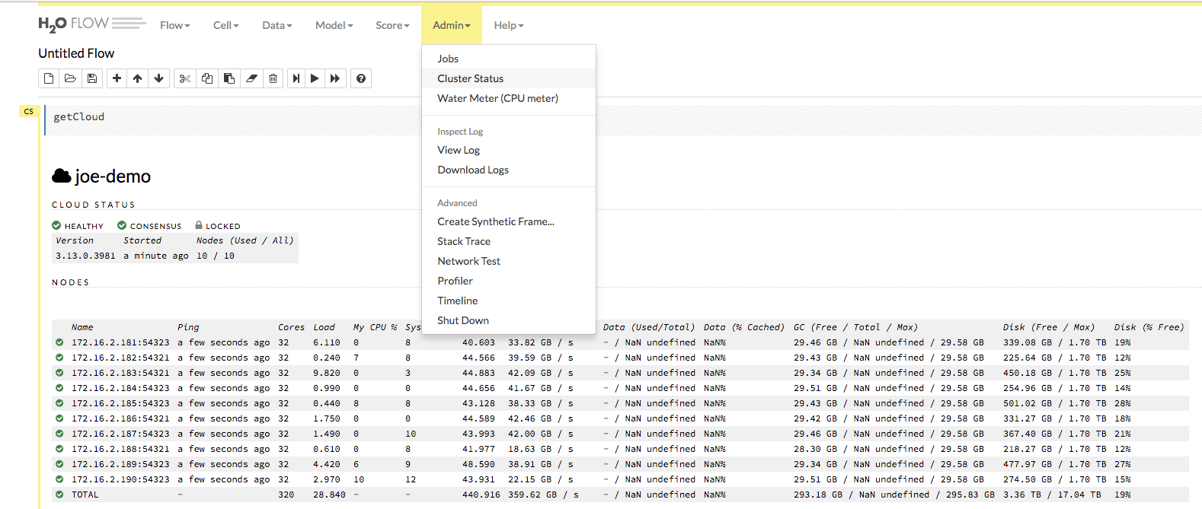
10 nodes
10 x 32 = 320 CPU 运算核
10 x 29.6 = 296 GB 记忆体

Slide 33
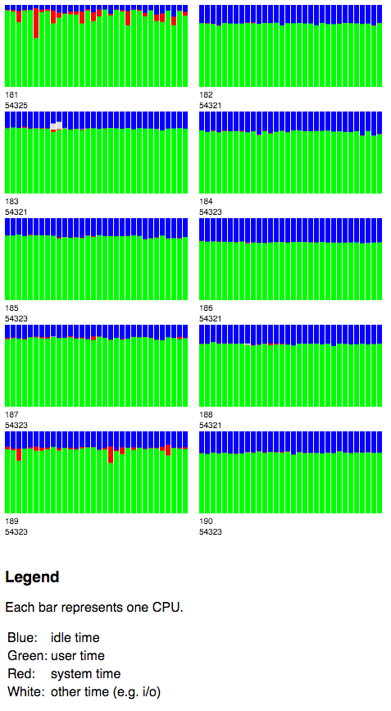
H₂O Water Meter (CPU 功率监视器)
10 x 32 = 320 Cores
自动分布式运算

Slide 34
High Level Architecture
多介面
HDFS
H₂O Compute Engine
S3
Load Data
Exploratory &
Descriptive
Analysis
Supervised &
Unsupervised
Modeling
Predict
Distributed
In-Memory
NFS
Feature Engineering &
Selection
Model Evaluation &
Selection
Data & Model Storage
Loss-less
Compression
Local
Data Prep Export:
Plain Old Java Object
Model Export:
Plain Old Java Object
SQL
Production Scoring Environment
Your
Imagination
Notes:
Works on Hadoop & Spark
Key capabilities
Distributed in-memory algorithms
Columnar compression
Feature Engineering
EDA
Data Munging
Supervised Learning Algorithms
Unsupervised Learning Algorithms
Model deployment via POJO

Slide 35
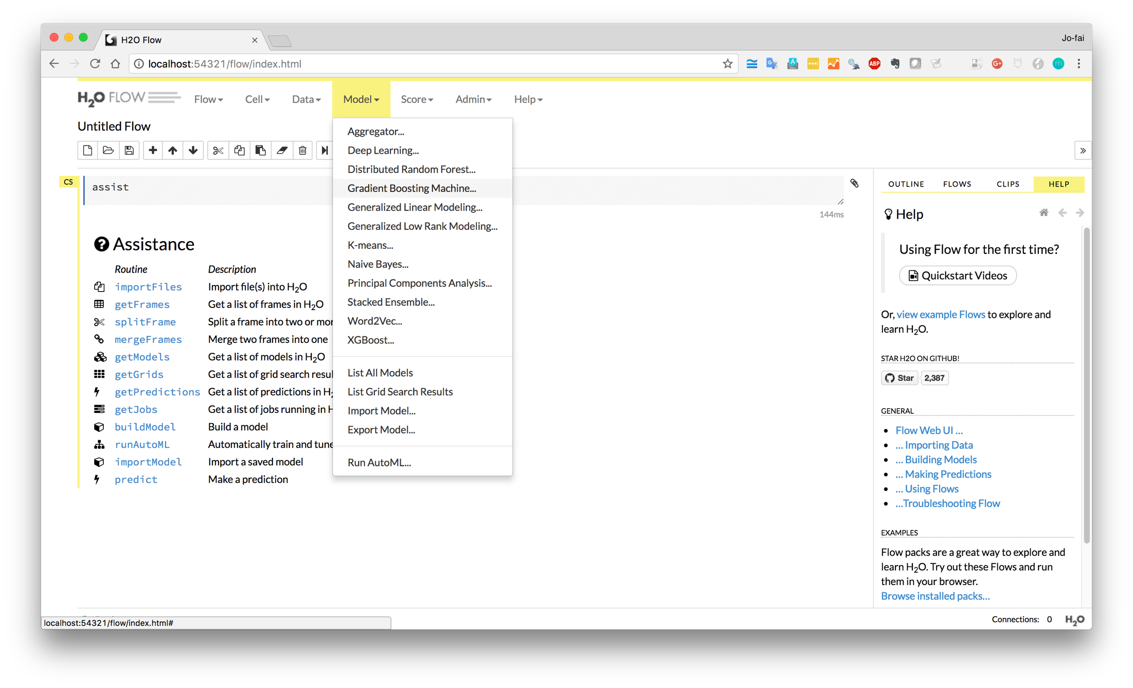
H₂O Flow (网页介面)

Slide 36
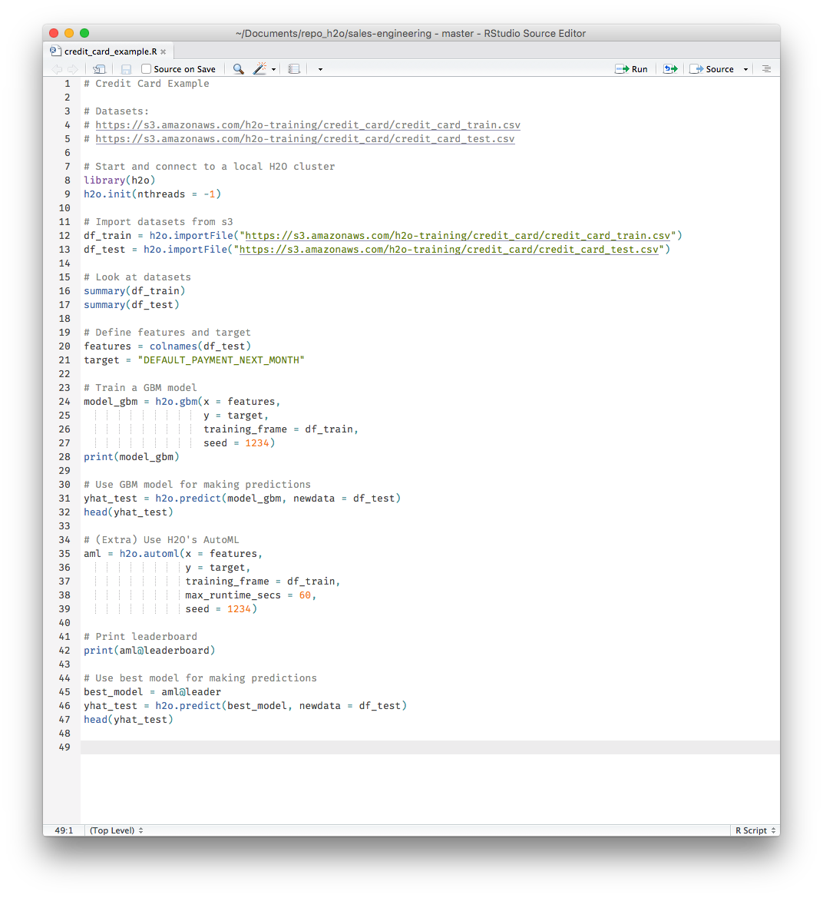
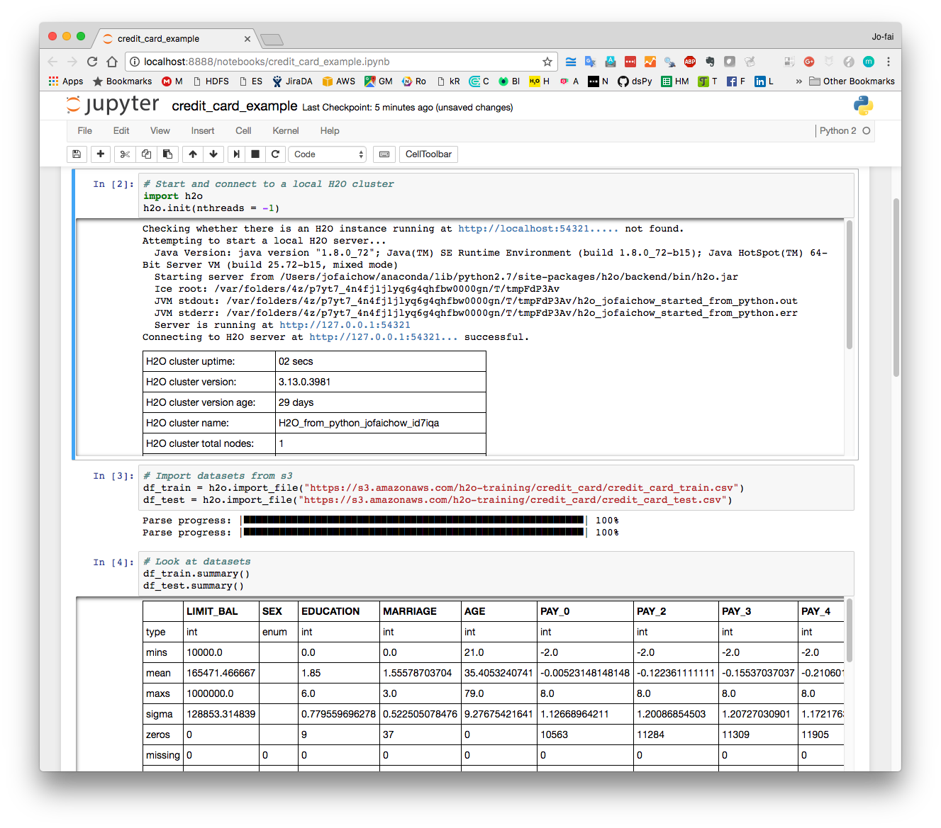
H₂O - R / Python 介面

Slide 37
High Level Architecture
导出生产的独立模型
HDFS
H₂O Compute Engine
S3
Load Data
Exploratory &
Descriptive
Analysis
Supervised &
Unsupervised
Modeling
Predict
Distributed
In-Memory
NFS
Feature Engineering &
Selection
Model Evaluation &
Selection
Data & Model Storage
Loss-less
Compression
Local
Data Prep Export:
Plain Old Java Object
Model Export:
Plain Old Java Object
SQL
Production Scoring Environment
Your
Imagination
Notes:
Works on Hadoop & Spark
Key capabilities
Distributed in-memory algorithms
Columnar compression
Feature Engineering
EDA
Data Munging
Supervised Learning Algorithms
Unsupervised Learning Algorithms
Model deployment via POJO

Slide 38
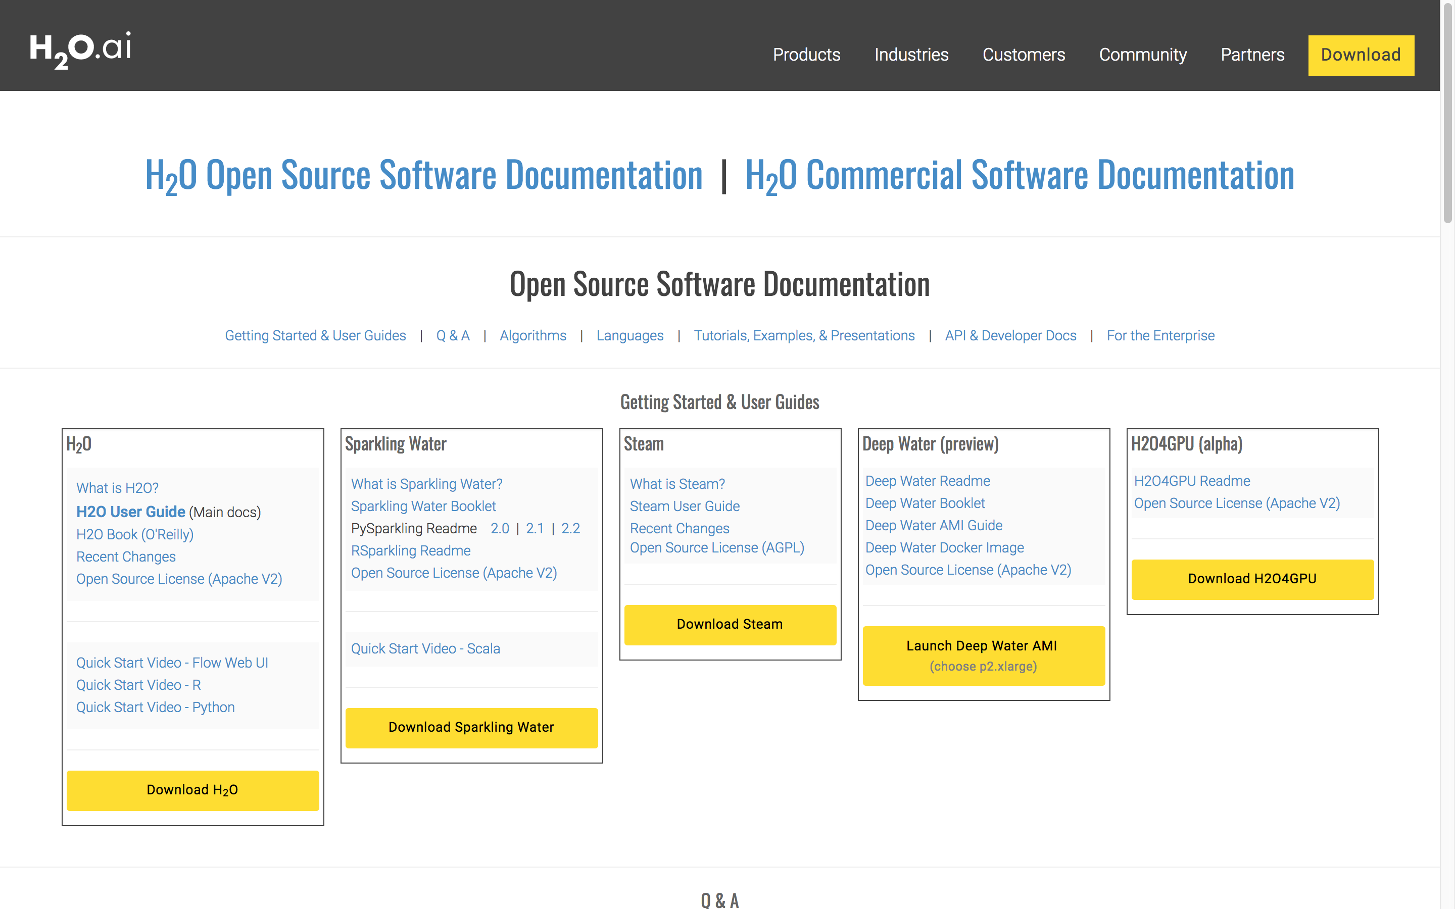
H₂O文档 docs.h2o.ai

Slide 39
Credit Card Demo
信用卡风险演示

Slide 40
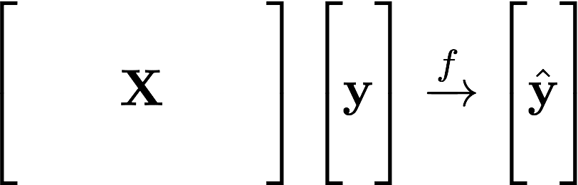
Learning from Data 从数据中学习
Learn the Pattern 学习模式
Historical
Value
过去的结果
Predicted
Value 预测值
Data Inputs 数据输入

Slide 41
Supervised Learning 监督学习
Regression: 回归分析
How much will a customers spend?
例：客户要花多少钱？
Classification: 分类分析
Will a customer make a purchase? Yes or No
例：顾客会购买吗？ 是或否
yes
no
y
x_{j}
X
x_{i}
H₂O algos 算法:
Penalized Linear Models
Random Forest
Gradient Boosting
Neural Networks
Stacked Ensembles
H₂O algos 算法:
Penalized Linear Models
Naïve Bayes
Random Forest
Gradient Boosting
Neural Networks
Stacked Ensembles

Slide 42
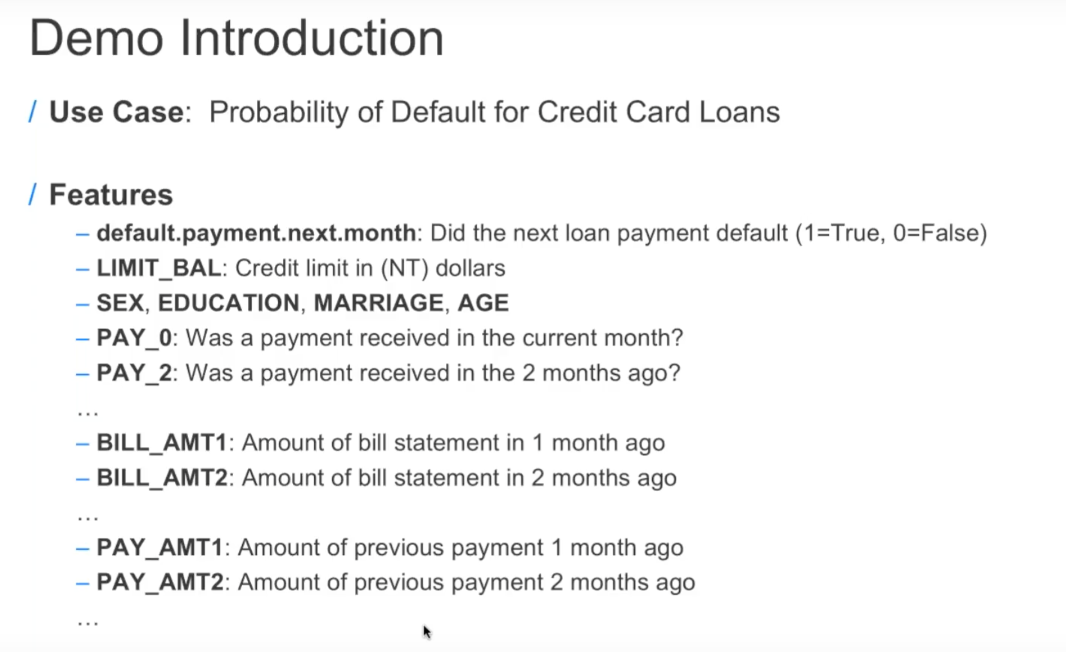
坏账
结余
性别, 教育，婚姻，年龄
支付历史

Slide 43
Learning from Credit Card Data 从信用卡数据中学习
机器学习
结余, 性别, 教育，
婚姻，年龄,
支付历史
过去的结果
坏账
(Yes/No)
预测值

Slide 44
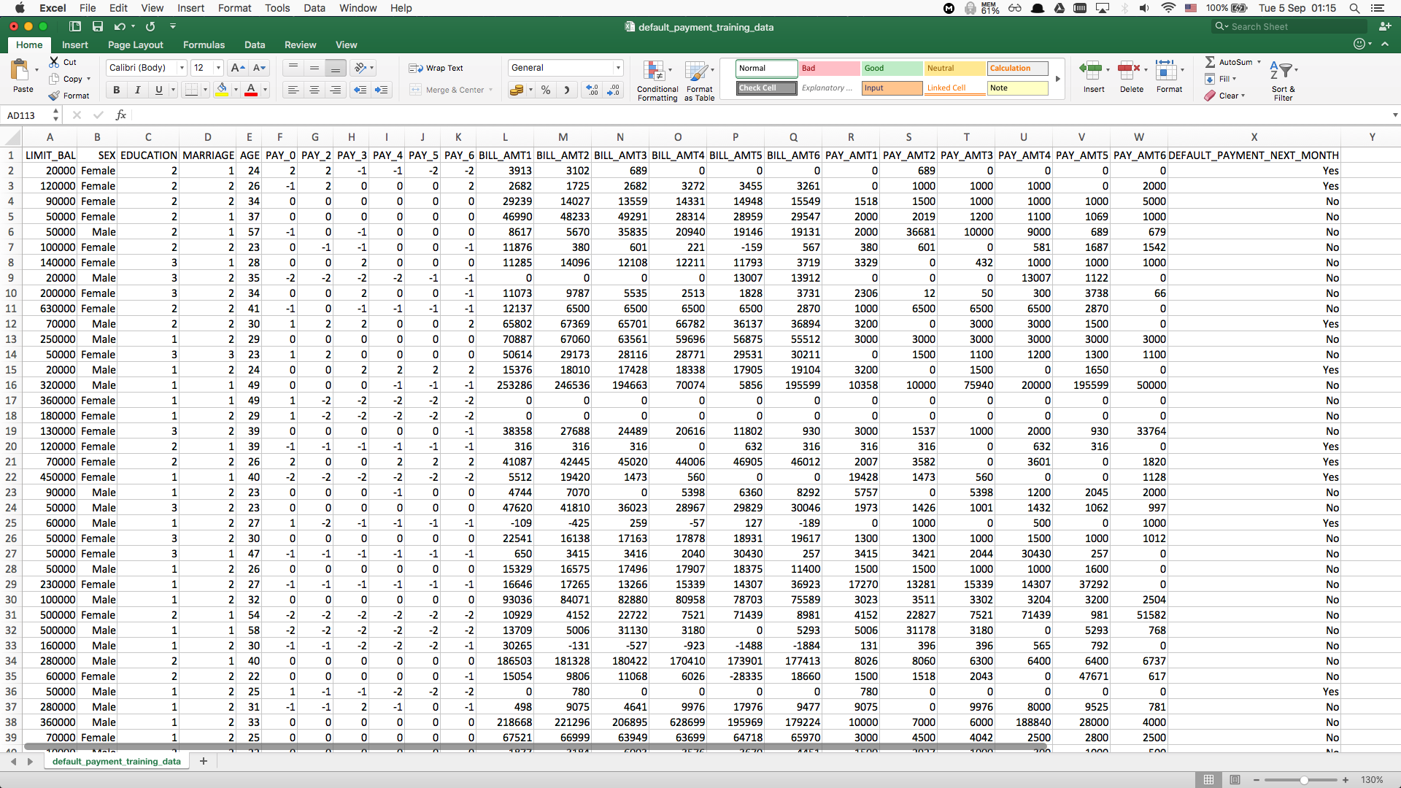
训练数据 credit_card_train.csv
数据输入 (x): 结余, 性别, 教育, 婚姻, 年龄, 支付历史
机器学习
过去的结果
坏账
(Yes/No)

Slide 45
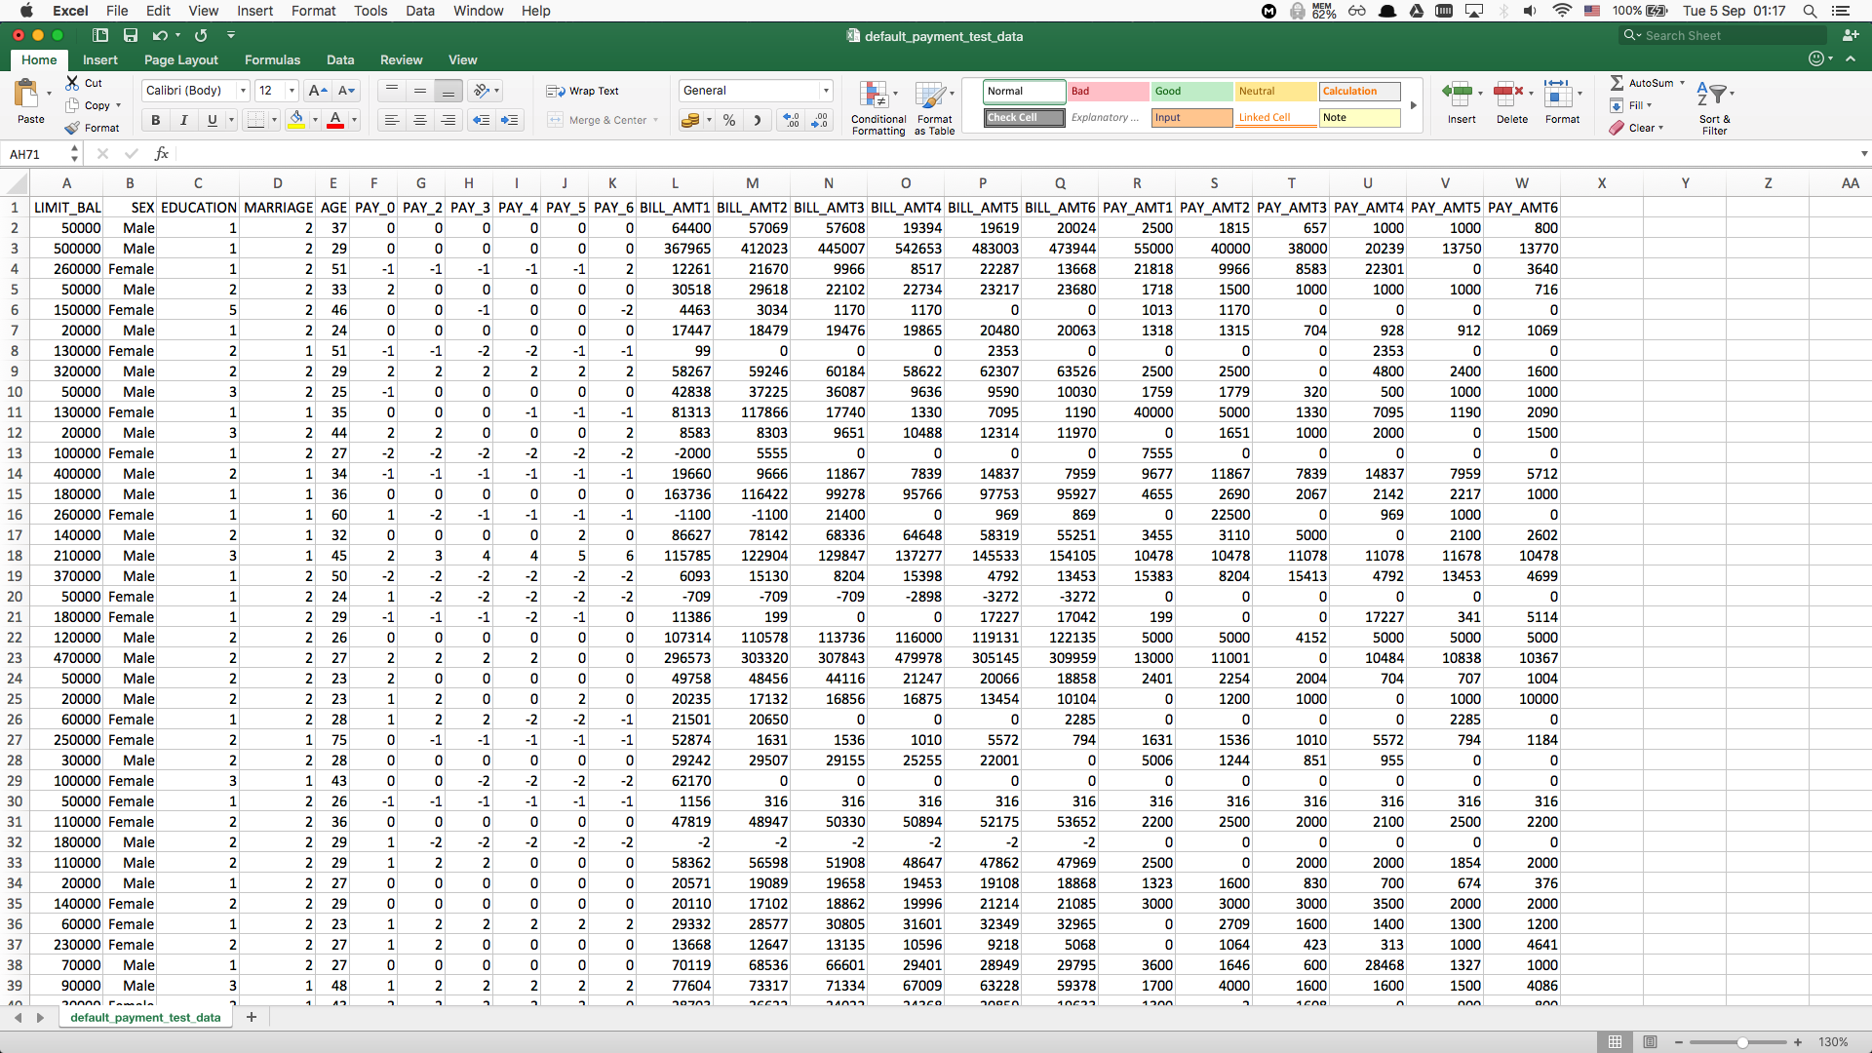
测试数据 credit_card_test.csv
数据输入 (x): 结余, 性别, 教育, 婚姻, 年龄, 支付历史
作出预测
坏账的概率
(决策者采取行动）

Slide 46
Live Demo 现场演示
Import and explore credit card dataset 导入并浏览信用卡数据集
Train a model and make predictions 训练模型并进行预测
Train many models using AutoML and make predictions using the best model 使用AutoML训练许多模型，并使用最佳模型进行预测

Slide 47
Driverless AI 无人驾驶的人工智能
Using AI to do AI 用人工智能制造人工智能

Slide 48
H₂O Platform Timeline H2O 平台时间表
Visual Interpretation
H2O
Driverless AI
Analysts
Auto ML
App Developers
Deep Water
Dev Ops
Steam
Developers/Engineers
Data.table
Sparkling Water
Advanced Data Scientists
H2O GPU Edition
H2O Core
GPU
Users
2012
2014
2016
2017
2018
2019
Roadmap

Slide 49
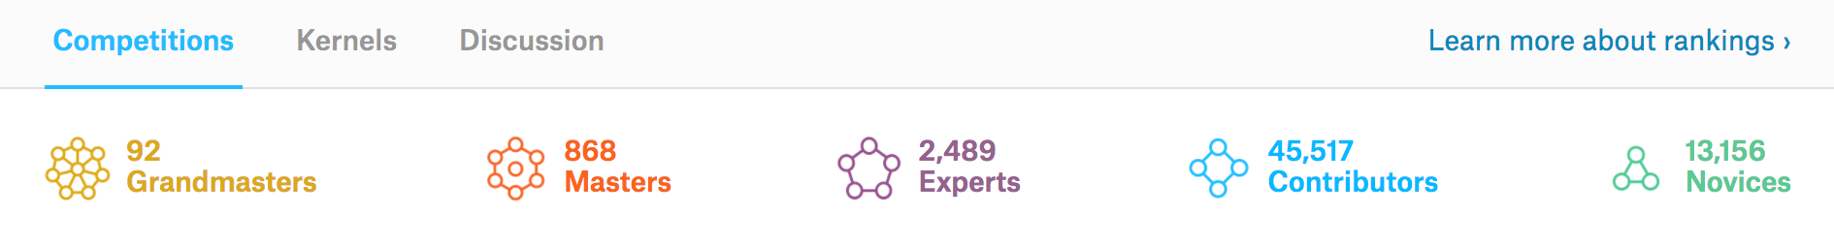
Shortage of Data Scientists 数据科学家的短缺
“The United States alone faces a shortage of 140,000 to 190,000 people with analytical expertise and 1.5 million managers and analysts”
“仅美国就有14万到19万拥有专业分析知识
的人的短缺，和150万管理人员的短缺”
–McKinsey Prediction for 2018
Kaggle是数据科学竞赛平台
顶级数据科学家

Slide 50
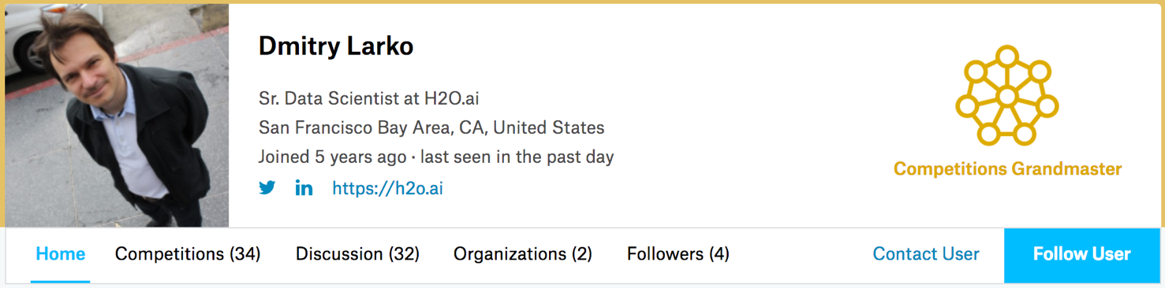
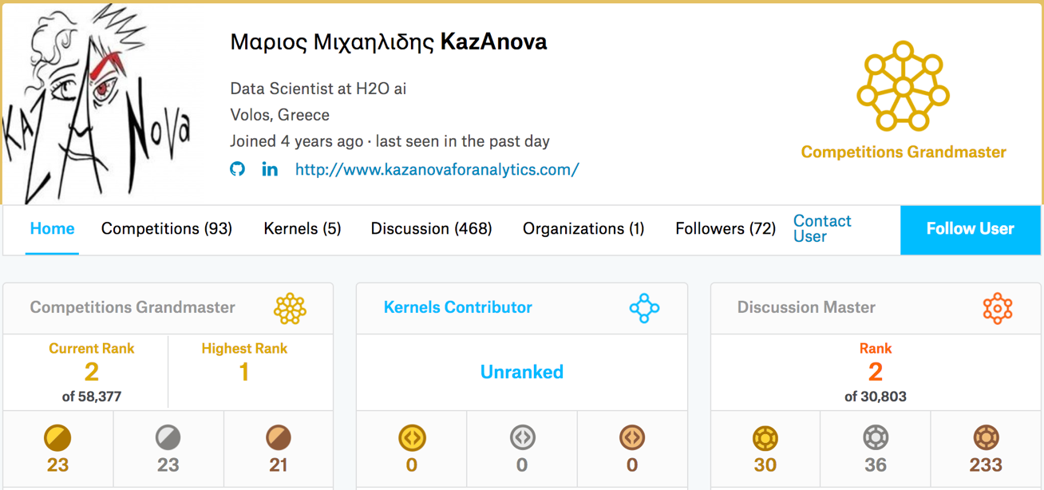

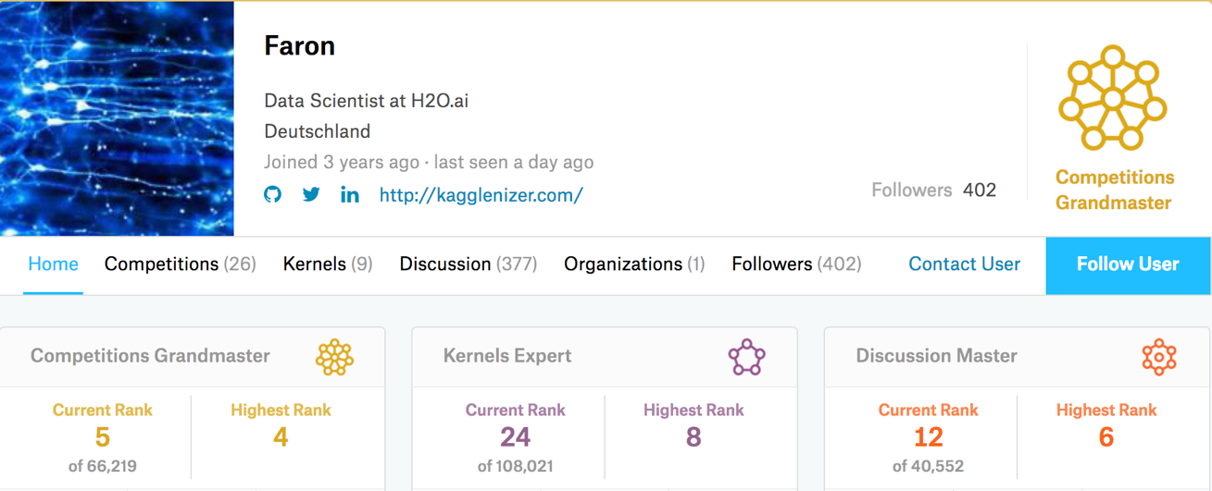

顶尖的数据科学家 Kaggle Masters at H₂O.ai

Slide 51
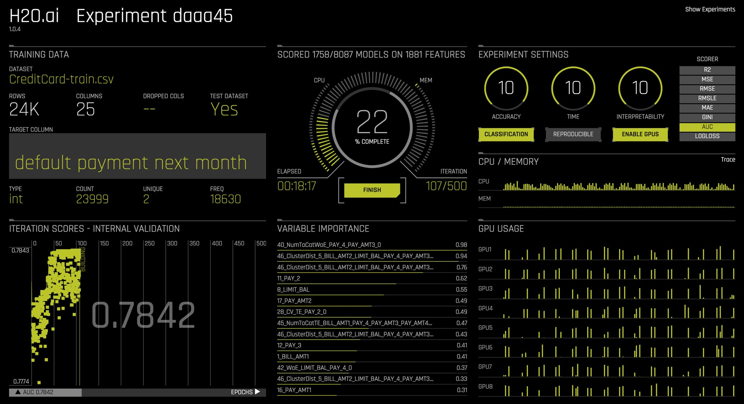
产品 The Product: Driverless AI
Kaggle Grandmasters in a Box 集合顶级数据科学家的智慧与经验
A solution to the shortage of data scientists
Fast 快速
H₂O Algorithms optimised for GPUs
Accurate 准确
Auto Feature Engineering
Auto Model Tuning / Selection / Ensemble
Interpretable 可解释
Machine Learning Interpretation
Production Ready 生产就绪
Export pipeline as a standalone Python package

Slide 52
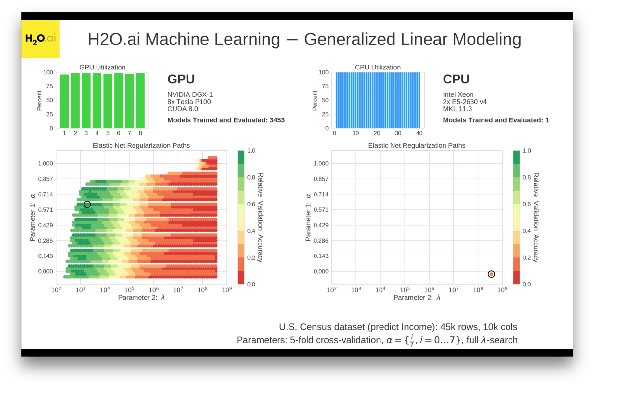
Fast 快速 : H₂O Algorithms on GPUs
在CPU完成第一个模型培训之时，
GPU上已经培训了3400个模型
https://www.youtube.com/watch?v=LrC3mBNG7WU

Slide 53




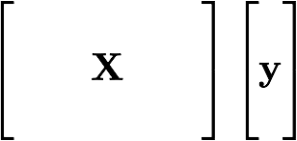
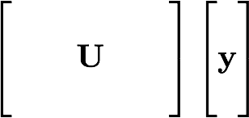
Accurate 准确 : Auto Feature Engineering 自动特征工程
Feature Transformation
Pipeline
Feature Engineering
Model
Training

Slide 54
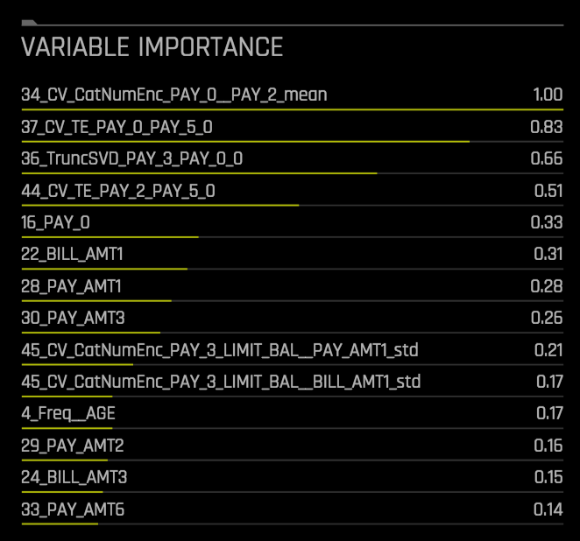
Accurate 准确 : Auto Feature Engineering 自动特征工程
Feature Transformations
Generated Features
Cross Validation Categorical Encoding
Frequency Encoding
Cross Validation Target Encoding
Truncated SVD and More
Original Features

Slide 55
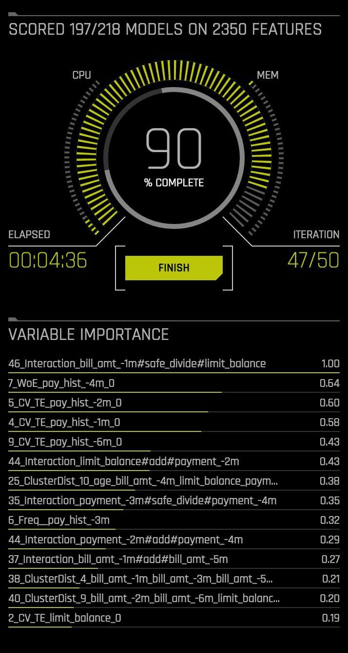
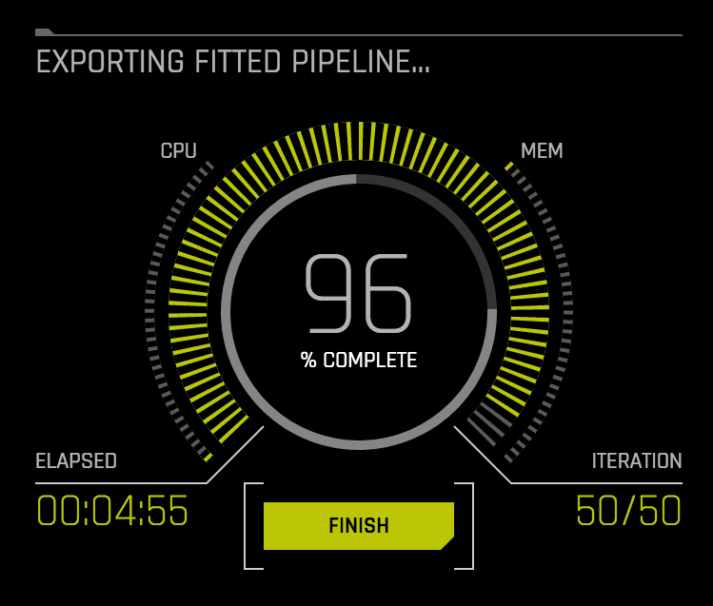
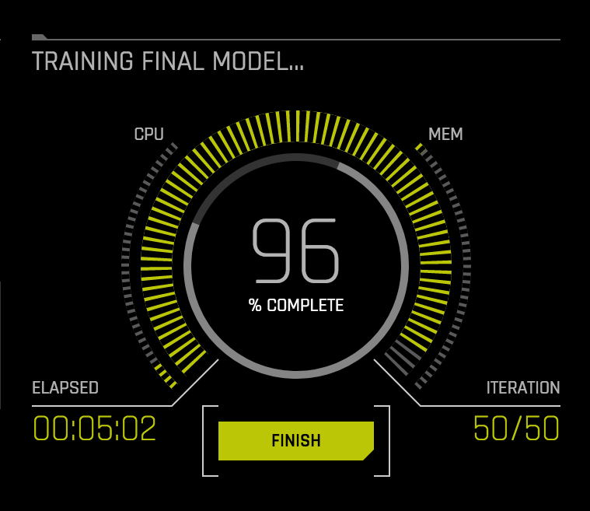
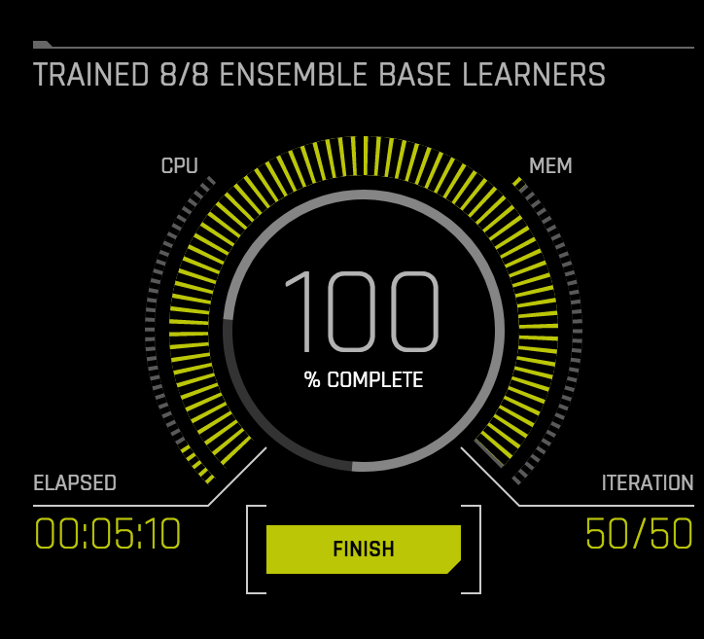
Accurate准确: 自动模型调整/选择/集合

Slide 56
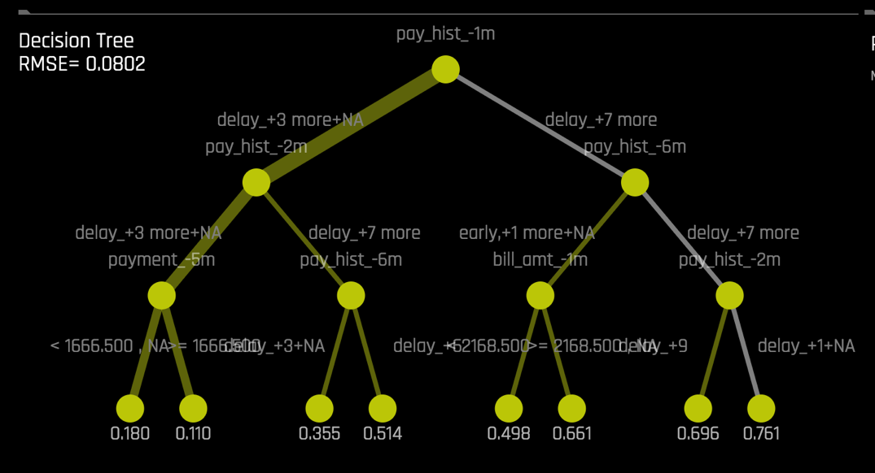
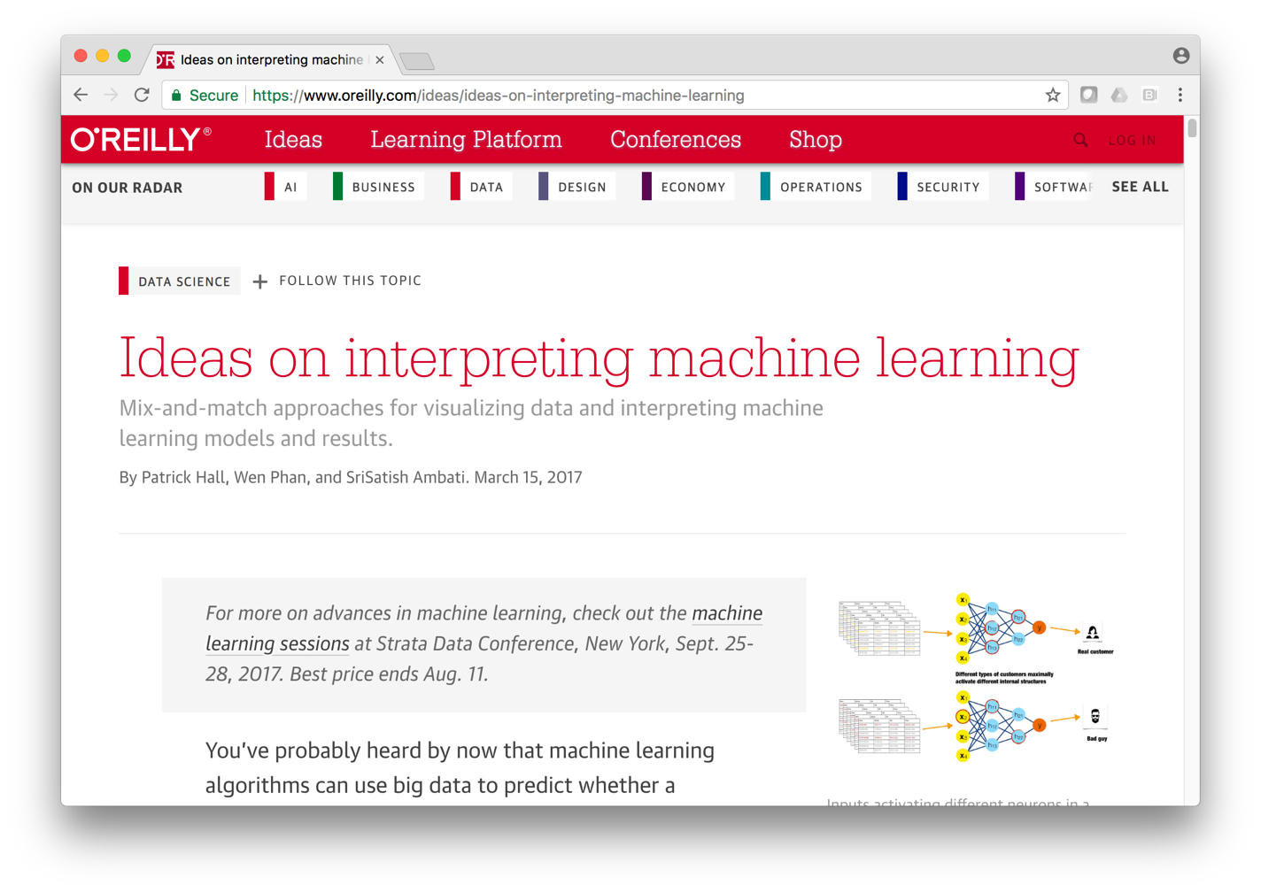
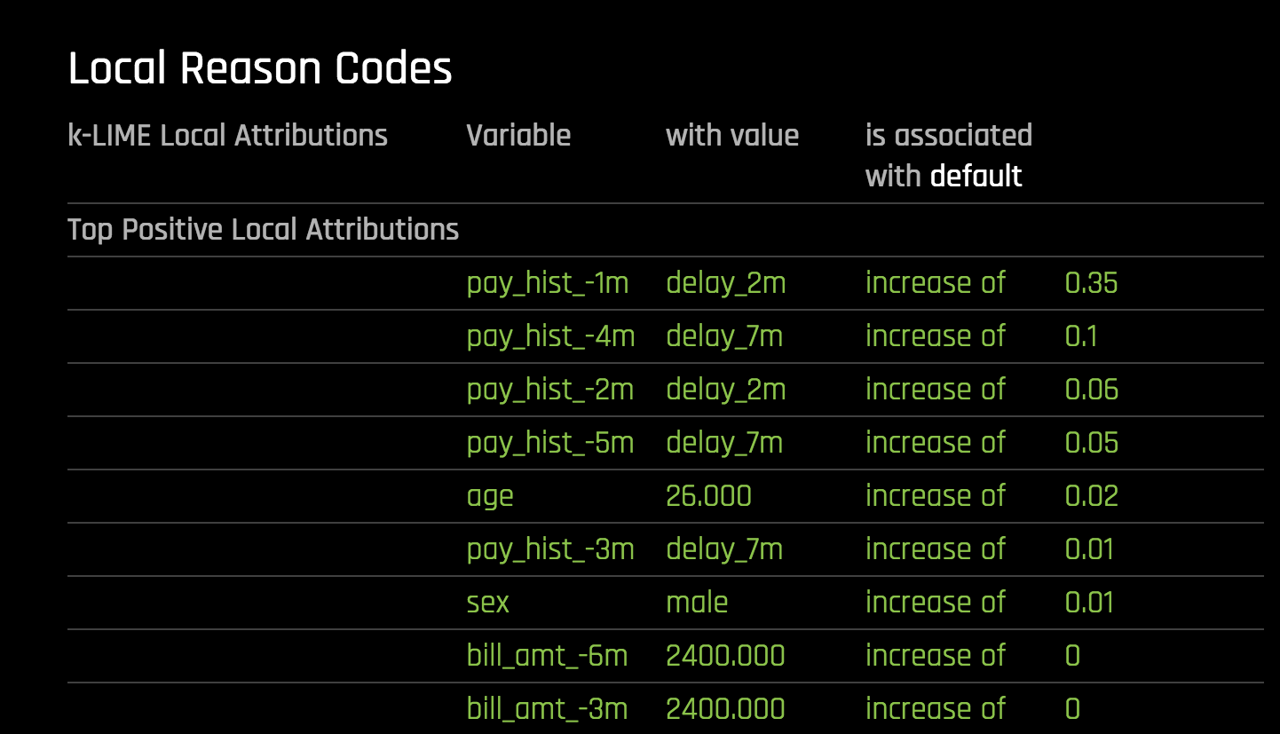
Interpretable: Explainable Machine Learning 可解释的机器学习
https://www.oreilly.com/ideas/ideas-on-interpreting-machine-learning

Slide 57
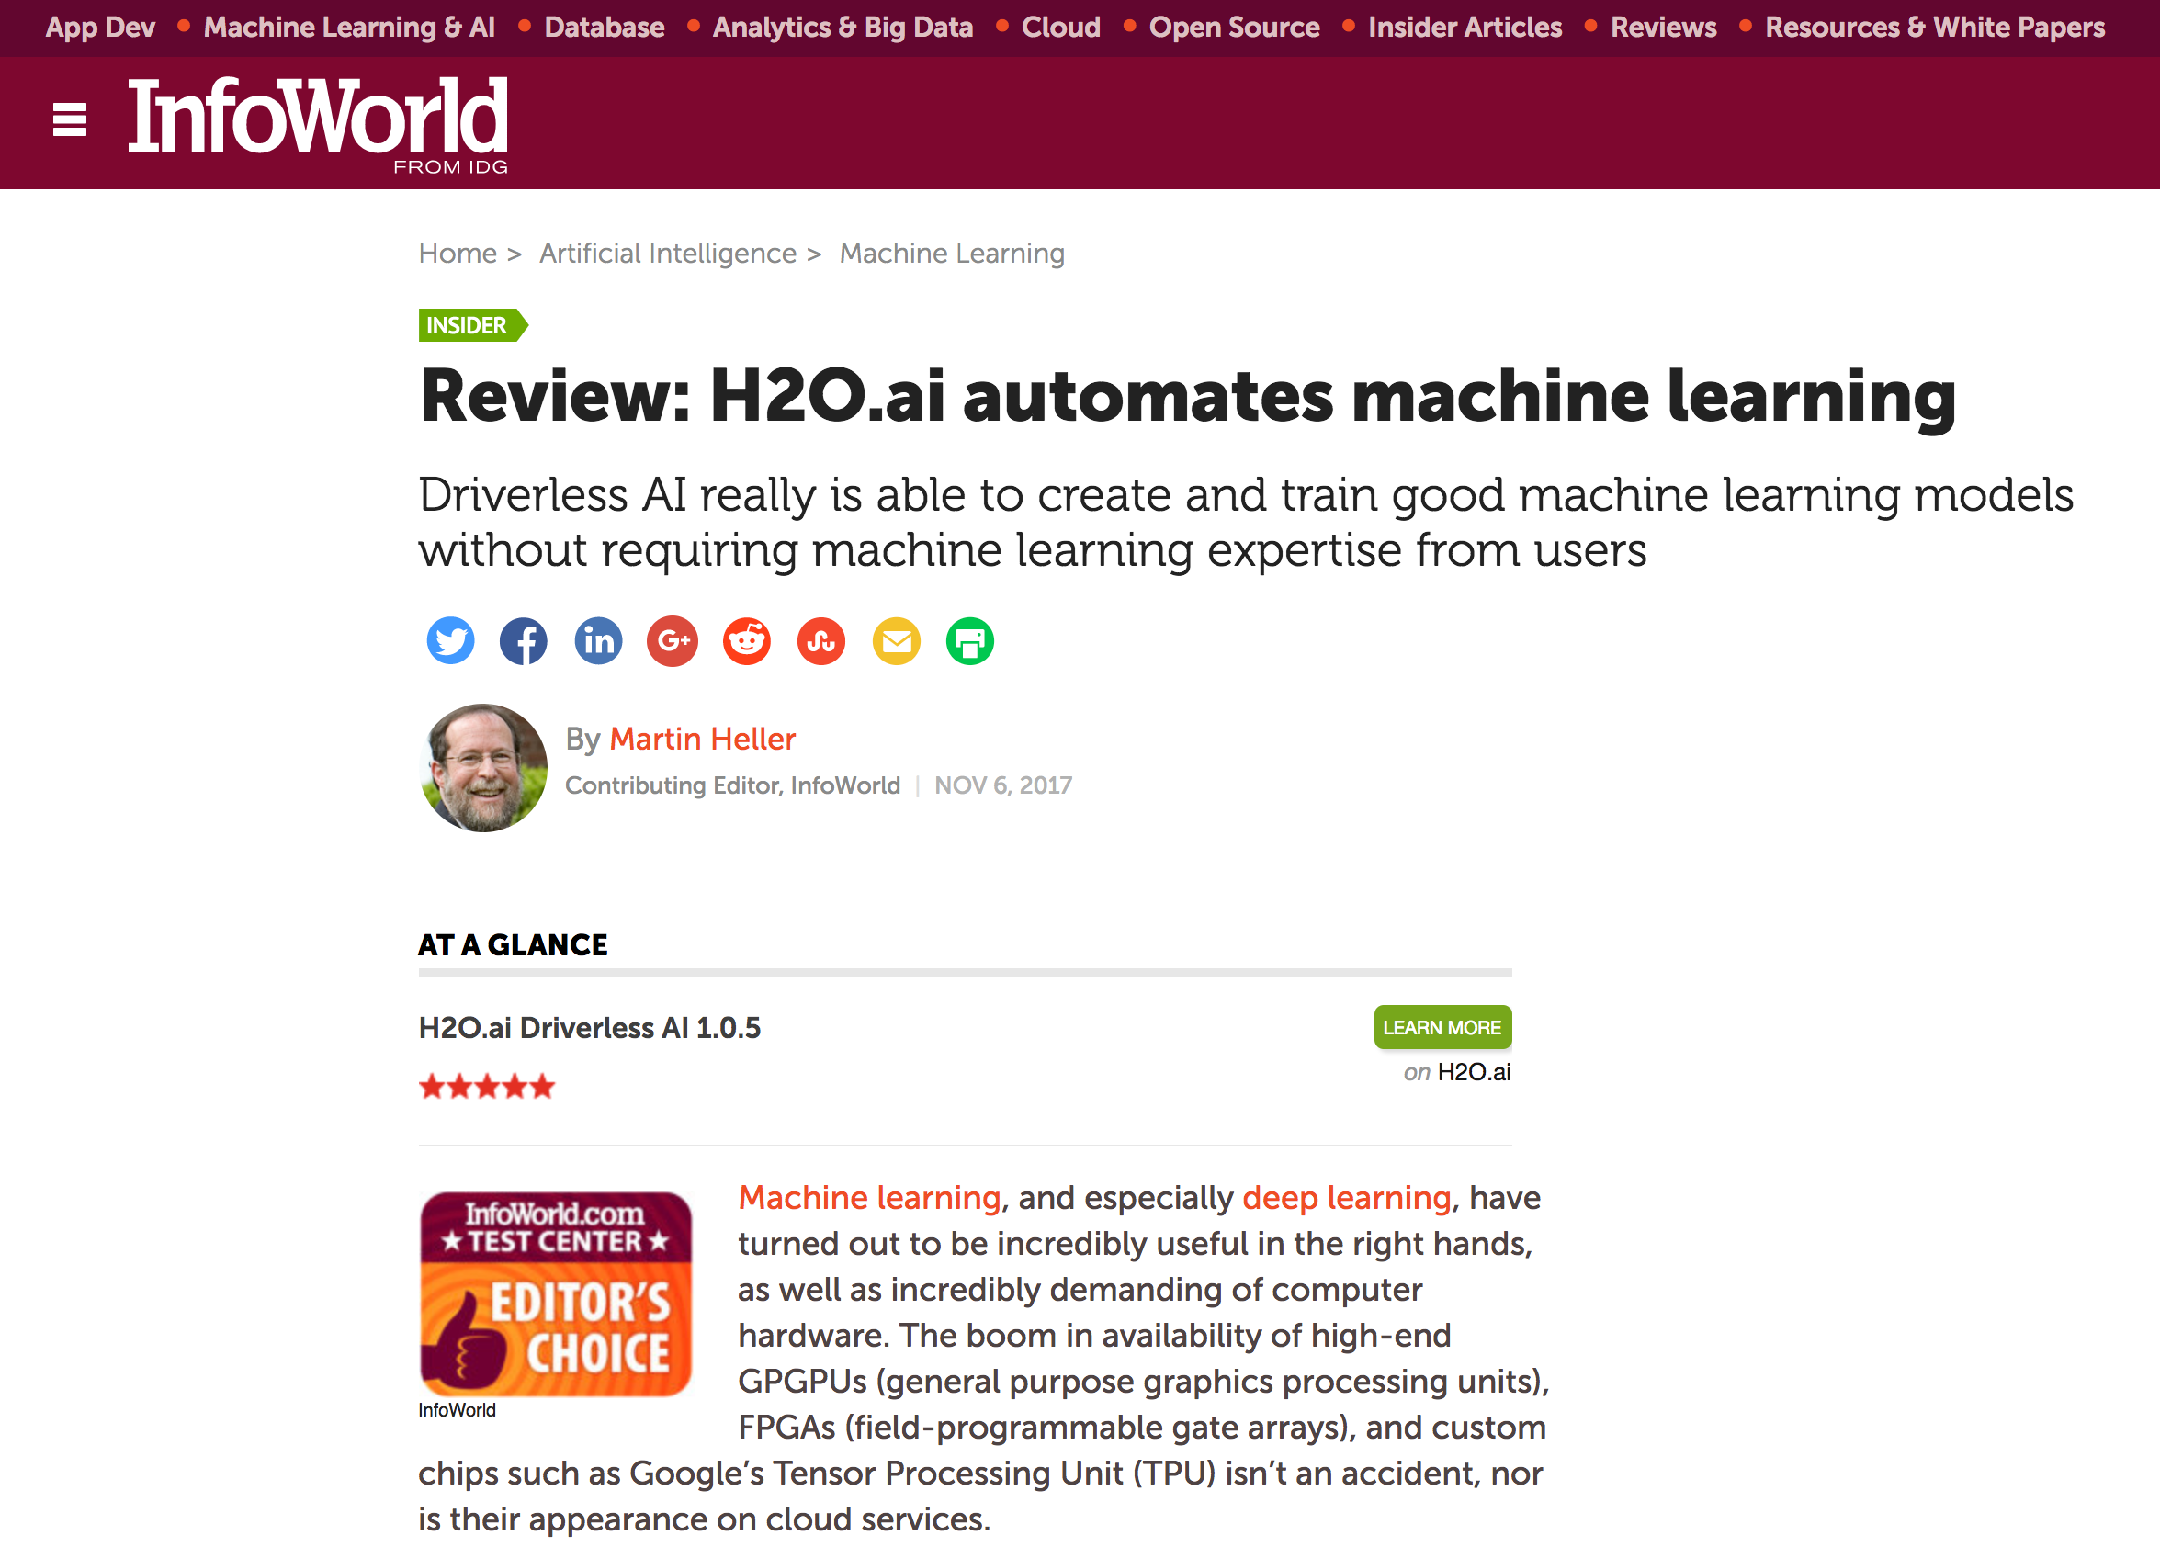
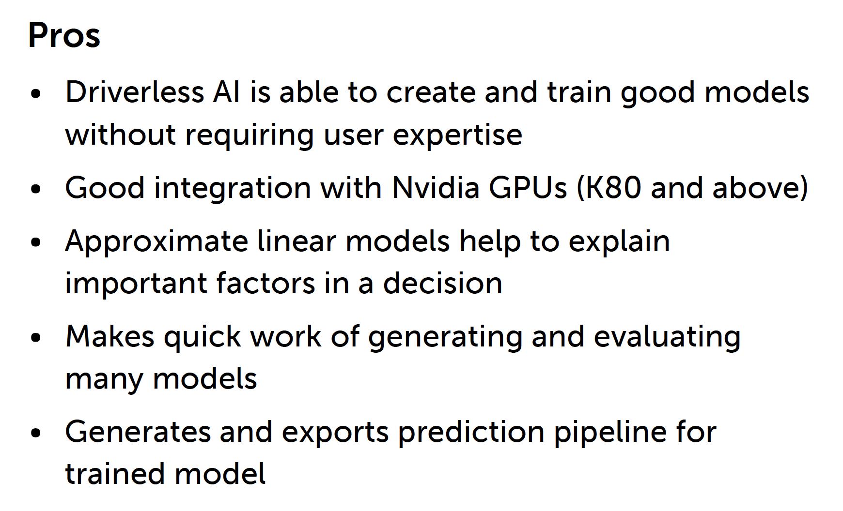

External Review 外部评论 - 五星为顶级
https://www.infoworld.com/article/3236048/machine-learning/review-h2oai-automates-machine-learning.html

Slide 58
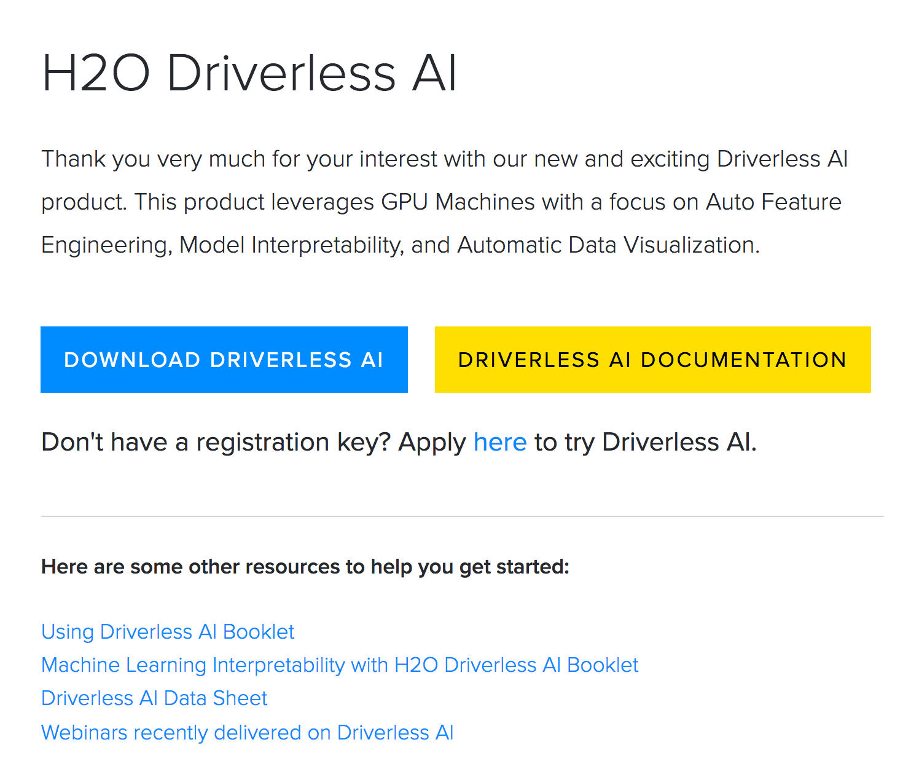
www.h2o.ai/driverless-ai-download/ 下载
30天的试用

Slide 59
Live Demo 现场演示
信用卡风险演示

Slide 60
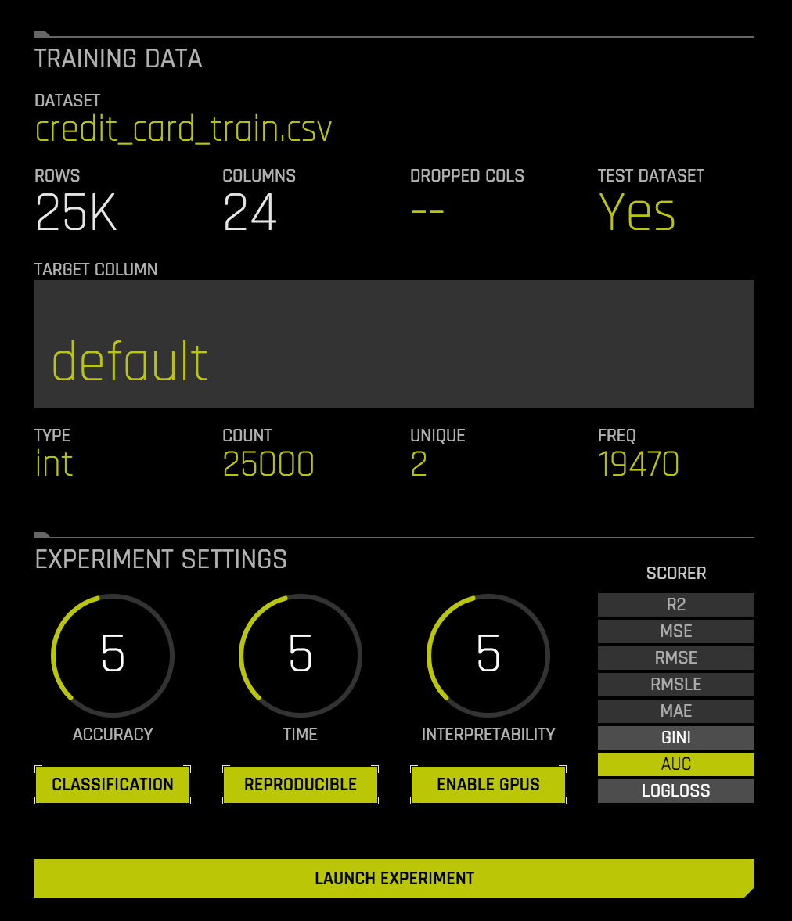
培训数据
测试数据
目标
简单的设置
选择度量标准

Slide 61
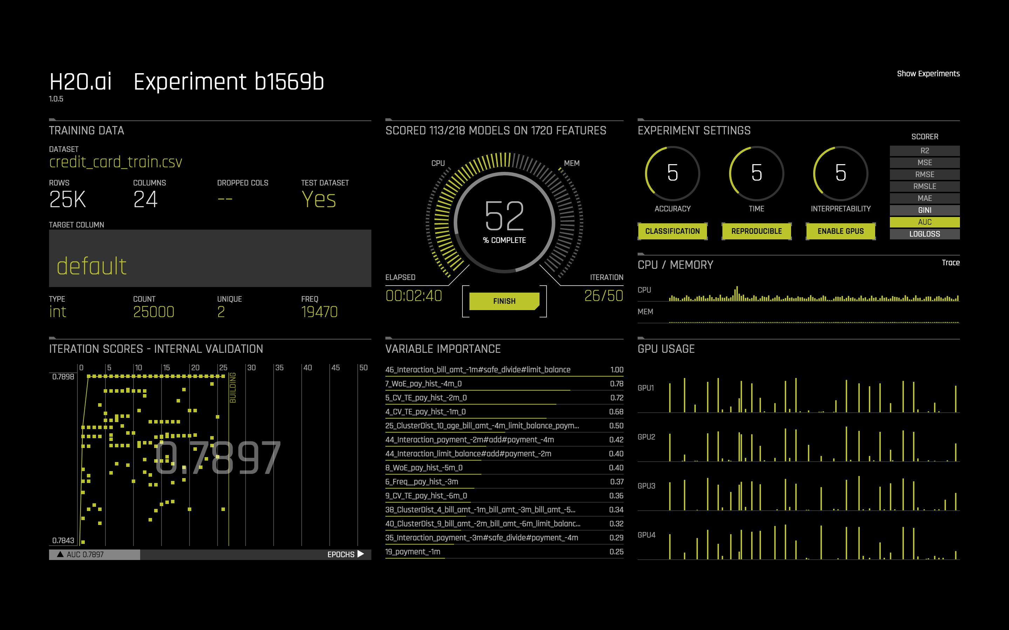
尝试不同的特征
自动特征工程
使用CPU和GPU

Slide 62
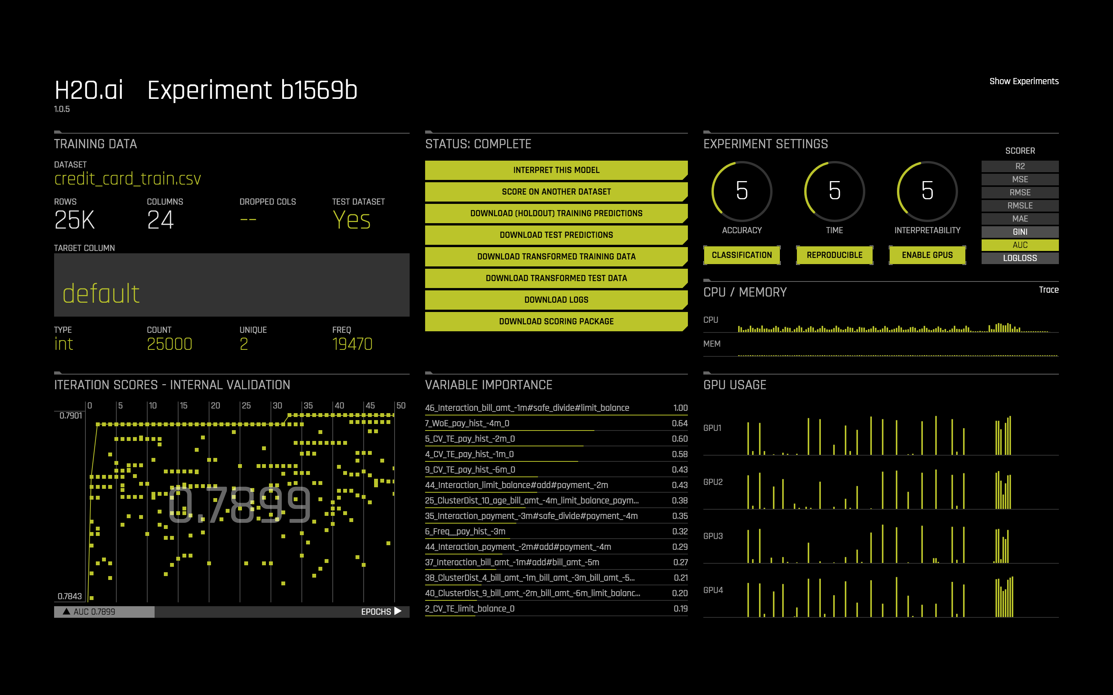
解释，评分，日志，管道

Slide 63
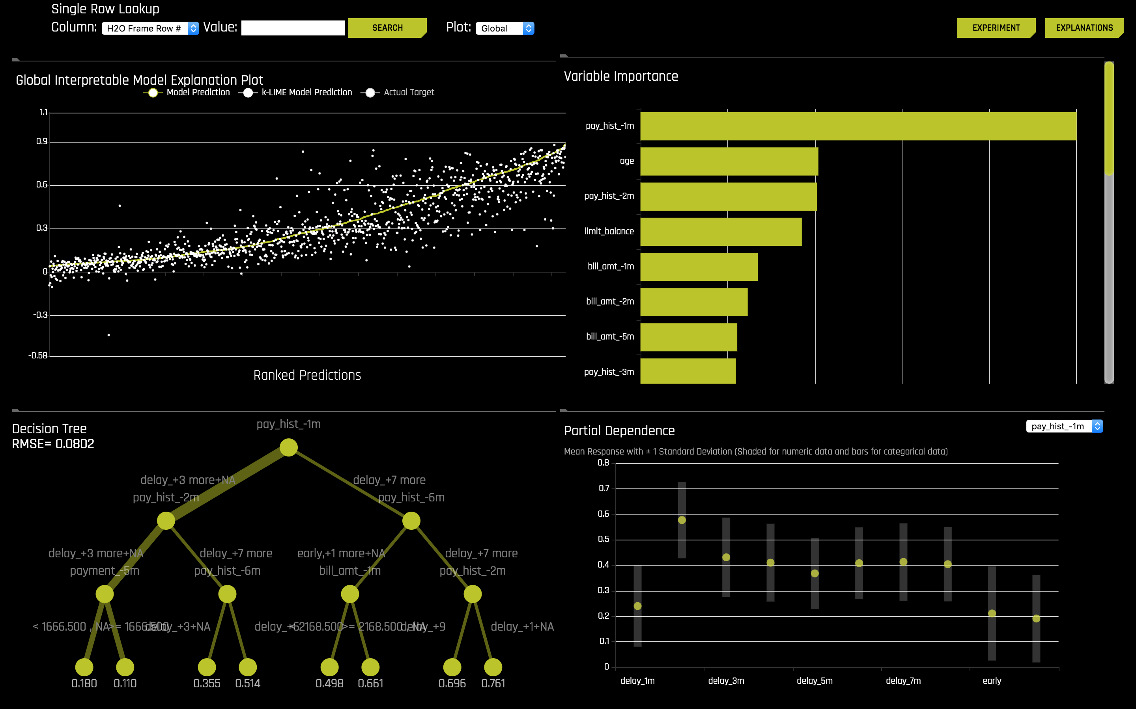

Slide 64
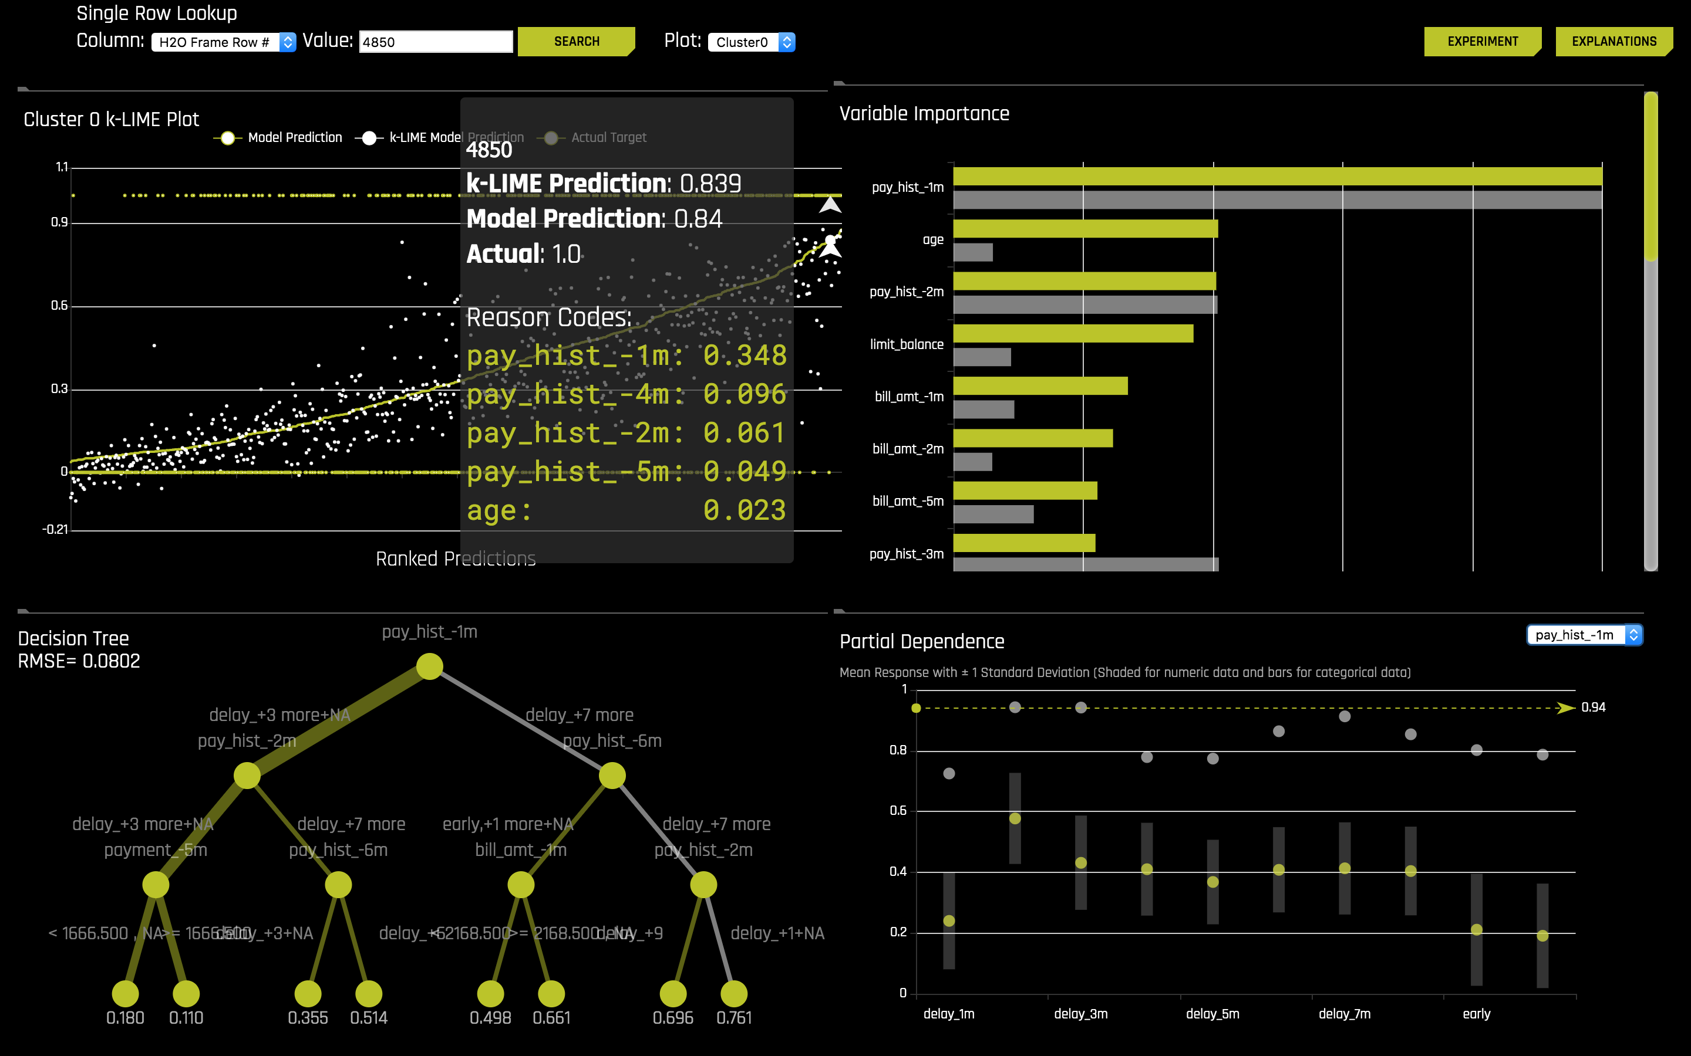
锁定到个人记录
用一个简单的决策树来解释如何产生结果

Slide 65

将决策树转换为原因代码

Slide 66


下载管道

Slide 67


独立的Python软件包

Slide 68
Q & A

